Slide 1
Lecture 10 Chapter 4
Establishment Clause II
(Lemon Test and Aid to Religious Schools)

Slide 2
This Lecture
More on the Establishment Clause
Pages 145-159
Burger and Rehnquist Courts
Lemon Test
Aid to Religious Schools

Slide 3
Walz v. Tax Commission of the City of New York (1970)
Walz v. Tax Commission of the City of New York (1970)
In this section, we move first to the Burger Court
Burger uses his position as Chief to assign many opinions to himself and manipulate outcomes→ it earns him the scorn of sever colleagues on the Court
Plaintiff challenges law making church property exempt from property taxes
Burger finds in favor of the government
Finds a secular purpose
But adds a new prong- “no excessive entangle” with religion
Only Douglas dissented

Slide 4
Lemon v. Kurtzman (1971) Early v. DiCenso (1971)
Background
Suit brought against the Supt. Of Pennsylvania schools
A law allowed him to purchase secular educational services for nonpublic schools
Would only go to the secular activities of religious schools→ books, salaries for the same course as taught in public schools→ schools had to keep records of this
Paid for by the state cigarette tax
This was about 20% of the school population
Nearly all were Catholic schools
The companion Rhode Island case used public funds to supplement private teacher salaries, so long as they taught separate subjects
Again, nearly all went to Catholic schools, and most to nuns

Slide 5
Lemon v. Kurtzman- II
Arguments
For Pennsylvania and Rhode Island
No tax money goes to support religious institutions or activities
There was a secular purpose→ to improve parochial school conditions
The monitoring violates excessive entanglement
For Kurtzman and Earley
Absolute separation not necessary→ only neutrality
The purpose is secular

Slide 6
Lemon v. Kurtzman- III
Burger, C.J. rules for the Court 8-0 (Lemon) and 8-1 (Earley)
He tries to figure out the meaning of “respecting”
Could lead to establishing a religion
His three prohibitions
Sponsorship
Financial support
Active involvement of the sovereign in religious activity
The Lemon Test
1) Secular legislative purpose
2) Primary or principal effect neither advances or inhibits religion
3) Must not foster an excessive entanglement of the government and religion

Slide 7
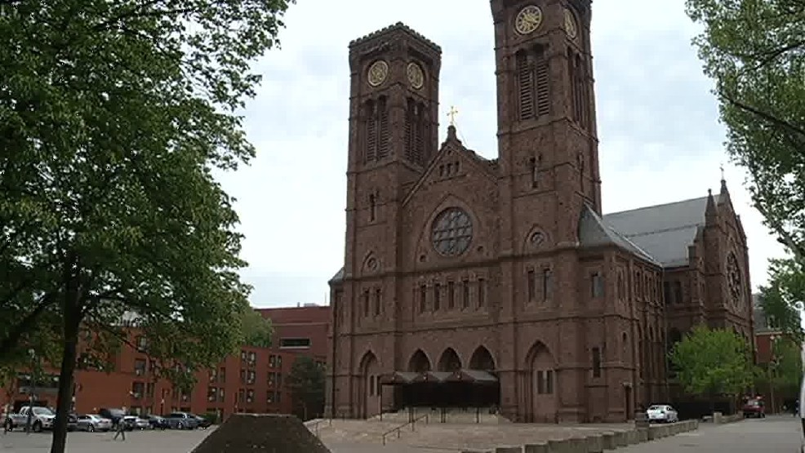
Lemon v. Kurtzman- IV
Application by Burger, C.J.
Secular purpose prong
Passes because intent was to improve all secular education, not to promote religion
Second prong not considered
Excessive entanglement prong
Both fail on this prong

Slide 8
Lemon v. Kurtzman- V
Excessive entanglement applied to each case
Rhode Island
He notes the schools getting the money have all been Catholic
Schools are often close to the church and contain many religious symbols
Most of the instructors are nuns, and this was part of the religious mission of the church
Most of the lay teachers are also Catholic
This is different than transportation, books, facilities
The Handbook for education by the Diocese encourages religion in teaching throughout
Unlike a book, a teacher cannot be inspected
Burger thinks it is impossible to monitor whether the teaching that is supplemented will actually only be secular

Slide 9
Lemon v. Kurtzman- VI
Excessive entanglement applied to each case
Pennsylvania
This is very similar to the Rhode Island case
However, reimbursements seem to go even further in ways that may touch religion
The money here also goes directly to church schools
Not to the student or his/her parents
Burger thinks there is no way to properly surveil to make sure public money does not go to religious education or activities

Slide 10
Lemon v. Kurtzman- VII
Douglas, J., concurring, joined by Black, J.
They disagree that money can sometimes go the secular parts of a religious school
They think there is no way to accurately calculate what is the secular part since things are so intertwined
They would simply say no to any public money to religious schools

Slide 11
Tilton v. Richardson (1971)
Tilton v. Richardson (1971)
Decided on the same day
Challenge to a provision of the Higher Education Facilities Act of 1963 that allowed for federal buildings grants to colleges so long as those facilities would not be used for religious instruction or worship
The Court largely upheld the law by a 5-4 vote
Burger, C.J. argued higher education was different on the third prong
However, they did strike down a provision that the schools got to use the buildings for what ever they want to after 20 years
He did also find the other two prongs were met

Slide 12
Government Aid to Religious Schools
The record under Burger, C.J. was mixed
They upheld transportation, textbook loans, buildings, and tax deductions
But struck down others such as paying to administer state run tests, counseling services, teacher salaries, and remedial instruction
However, the Rehnquist Court began to shift more in favor of funding
They allowed tuition for disabled students, special education programs, library services, computer material purchases, and instruction materials
They would then have to face the issue of school vouchers

Slide 13
Zelman v. Simmons-Harris (2002)
Background
Cleveland’s public schools were a mess
Ohio’s response was (among others) to provide a scholarship to attend private schools, whether religious or non-religious
Amount based on income, and went directly to parents who then signed the checks over to the schools→ they also had to pay some of the tuition themselves ($250)
Schools could only charge $2500 in tuition (up to 90% paid by state)
Religious schools were the choice of 96.7% of parents
Most were not a member of the faith of the schools they attended
The state lost at the district court and 6th Circuit and appealed

Slide 14
Zelman v. Simmons-Harris- II
Arguments
For the State of Ohio (Zelman)
The law is religiously neutral
No incentives are provided for the religious schools
It does not endorse religion
Schools that accept the money cannot discriminate
For Simons-Harris
It provides money to religious education
It creates a perception of endorsement of the religions of the schools
The options are nearly all religious

Slide 15
Zelman v. Simmons-Harris- III
Rehnquist, C.J. rules for a 5-4 Court
The purpose prong is clear→ adopted to improve education for students in a very bad school district by giving options
The main question is whether this advances or inhibits religion
He sees a distinction between programs
Those that provide money directly to religious schools→ those cases were allowed too
Those that involve the private choice of individuals are allowed
Mueller (1983)- Deductions for private school expenses (choice by parents)
Witters (1986)- Vocational scholarship at a religious school (program administered neutrally)
Zobrest (1993)- Sign language interpreters in religious schools (children were the beneficiaries)

Slide 16
Zelman v. Simmons-Harris- IV
More from Rehnquist, C.J.
The question was whether the programs were neutrally administered and are based on the private decision by individuals to send their money there
Not important what the results is
The incidental advancement or perceived endorsement is to the individual, not government

Slide 17
Zelman v. Simmons-Harris- V
Application to this case
Similar to these three cases
Program administered neutrally, all schools can participate, no preference to religion in the admission of students except for income
There is actually a disincentive to religion→ they take these students at less money than those that pay their way
The 96% figure is irrelevant
This is a program of private choice

Slide 18
Zelman v. Simmons-Harris- VI
Concurrences
Thomas, J.
He makes more of a political argument (opposes affirmative action, supports vouchers)
O’Connor, J.
She emphasizes that this does not depart from the Lemon test, but is a proper application
Agostini folded the second and third prongs together
Two factors to consider
1) Is the program administered in a religiously neutral fashion?
2) Is there a genuine choice among beneficiaries between religious and non-religious options?
In contrast, Rehnquist, C.J. largely ignored Lemon
Note: States may still have problems with their state constitutions!

Slide 19
Zelman v. Simmons-Harris- VII
The dissents
Breyer, J. joined by Stevens and Souter, JJ.
Does not buy the parental choice argument→ this is still funding church schools
This still creates a big conflict
Souter, joined by Stevens, Ginsburg, and Breyer, JJ.
He believes that Everson’s language on no tax money going to religious activities or institutions answers this question and the answer is no
The money here will go for religious instruction
Stevens, J.
He fears religious strife
They are removing a brick from the wall separating church and state

Slide 20
Next lecture
Pages 159-176
Access to public facilities and funds
Religious principals in public schools
Edwards v. Aguilar (1987)
Prayer and schools and other events
Extra-curricular activities and graduations
Government meetings- Town of Greece v. Galloway (2014)

