Slide 1
Lecture 12 Chapter 4
Establishment Clause IV
(Religious Displays and Government Involvement in Religion)

Slide 2
This Lecture
Establishment Clause Wrap Up
Pages 176-190
Religious Displays
Government involvement in the affairs of religious organizations
Van Orden v. Perry (2005)
Hosanna-Tabor Evangelical Lutheran Church and School v. Equal Opportunity Employment Commission (2012)

Slide 3
Lynch v. Donnelly (1984)
Lynch v. Donnelly (1984)
The City of Pawtucket, Rhode Island merchants put up a Christmas display every year
It had Santa, reindeer, a Christmas tree, lights, Season’s Greetings banner, and a nativity scene (crèche)
The city paid for the crèche and to put it up
The city said there was a secular purpose- attracting customers downtown
Burger, C.J. ruled for the city in a 5-4 ruling
An important part was that the crèche was only one part of the display
Also, he spoke of the unbroken history of official acknowledgement of religion in American life by all three braches of government
He suggested Christmas was so routed in American culture that it was a non-sectarian holiday
O’Connor had important language in her concurrence- “Endorsement sends a message to nonadherents that they are outsiders, not full members of the political community, and an accompanying message to adherents that they are insiders, favored members of the political community”

Slide 4
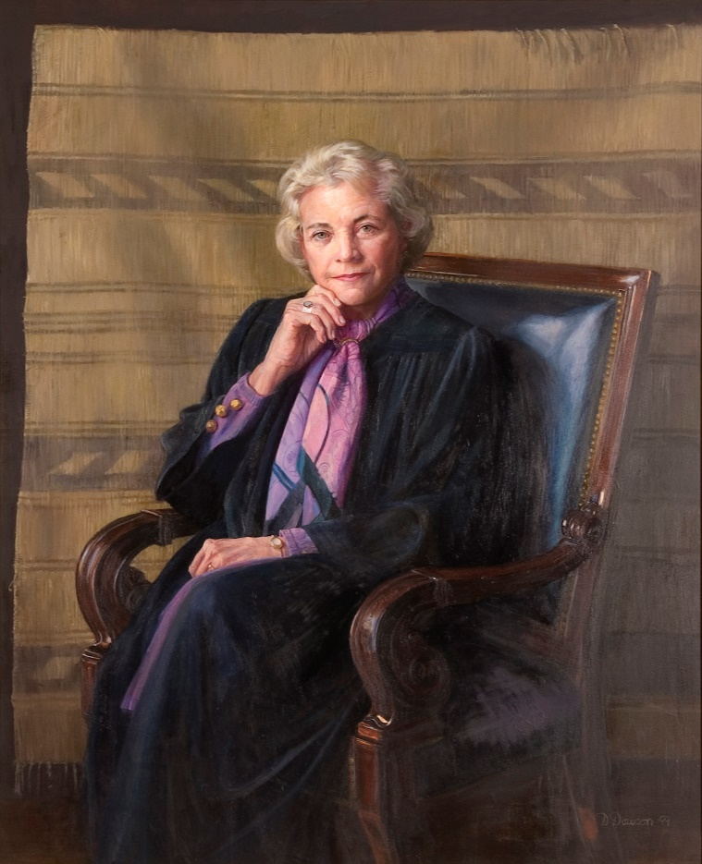
Justice O’Connor on Endorsement
Justice O’Connor had an important concurrence
Since she will soon be the swing vote on the Court
“Endorsement sends a message to nonadherents that they are outsiders, not full members of the political community, and an accompanying message to adherents that they are insiders, favored members of the political community”

Slide 5
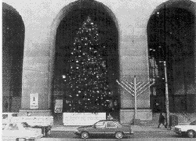
County of Allegheny v. ACLU (1989)
Justice Nativity scene Menorah
Blackmun violation constitutional
O'Connor violation constitutional
Brennan violation violation
Stevens violation violation
Marshall violation violation
Kennedy constitutional constitutional
White constitutional constitutional
Scalia constitutional constitutional
Rehnquist constitutional constitutional
Challenge to two displays in Pittsburgh
One a large crèche that belonged to a Catholic group
The other a large menorah, which was next to an even larger Christmas tree
The menorah was owned by a Jewish group
Blackmun, J. ruled for a badly divided Court
The crèche, but itself violated the Establishment Clause
It stood alone and said “Glory to God for the birth of Jesus Christ”
However, the menorah and Christmas tree did not
These were placed together
Showing the religious heritage of the country
He based much of his opinion on “endorsement” of religion

Slide 6
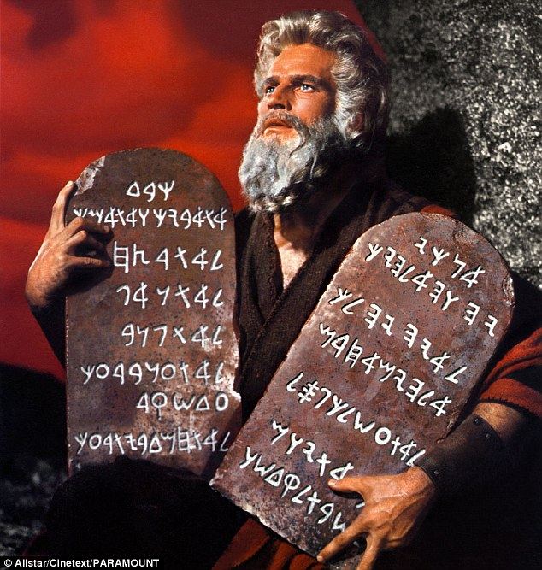
Stone v. Graham (1980)
Kentucky law required display of the Ten Commandments in every public school classroom
Paid for by private organization
A 5-4 Court (per curiam) found no secular purpose
Because it talks about things purely religious
It also seemed to endorse religion
Rehnquist, J. found that the Ten Commandments had a long history in regard to laws of the Western world

Slide 7
McCreary County v. ACLU (2005)
McCreary County v. ACLU (2005)
Decided the same day as Van Orden
Ten Commandment displays in several Kentucky courthouses
Along with other historical legal documents
They had put these up recently
Explicitly identify that it came from the King James Version of the Bible
The Court found religious purpose in the erection of the display

Slide 8
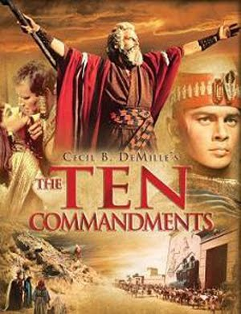
Van Orden v. Perry (2005)
Background
A Ten Commandments monument (six feet tall) was erected on the Texas State Capital grounds in 1961
It was donated by the Eagles as part of a program by Cecile B. DeMille
It was with many other monuments and displays
Van Orden thought the state was endorsing religion by its display

Slide 9
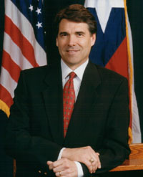
Van Orden v. Perry- II
Arguments
For Van Orden
The Ten Commandments expresses a religious message
The prominent placement shows it has no secular purpose and endorses a religion
For Rick Perry
The monument is smaller than others
It is an ancient legal code, thus not religious purpose
It is not state policy
It simply shows influence on culture and law

Slide 10
Van Orden v. Perry- III
Rehnquist, C.J. announced the judgement of the Court, joined by Scalia, Kennedy, and Thomas, JJ.
One can tell they are not a fan of Lemon
And do not use it here
Rehnquist cites to cases that recognize the importance of religion in society
He even points to laws recognizing prohibitions on sales on Sunday
He notes Moses on the Supreme Court building
Moses was also a secular law giver
This case is not a school case
The Ten Commandments are both secular and religious

Slide 11
Van Orden v. Perry- IV
Concurrence by Scalia
The Establishment Clause should be read to not prohibit things that favor religion generally
This was not proselytizing
Concurrence by Thomas
He would interpret this
Prohibiting actual establishment of religion
And an coercion

Slide 12
Van Orden v. Perry- V
Breyer, J. concurring in the judgment
Breyer had voted against religious displays in McCreary County, but was in the majority upholding these
He was the swing vote
He acknowledges it was a religious message
But also a secular one
He notes how long the monument has been there and how many others are on the grounds
He sees a mixed rather than religious message
He does not want to send a message of hostility towards religion

Slide 13
Van Orden v. Perry- VI
Stevens, J. joined by Ginsburg, J.
This is a state endorsement of a religion given the words
It is not neutral
Souter, J. joined by Stevens and Ginsburg
Notes “I am the Lord they God” written in larger type
Other commandments religious
Two stars of David
Not religiously neutral

Slide 14
When can government enter the affairs of a religious organization?
What about internal operations?
Is this not excessive entanglement?
But some go beyond a purely religious message
When do they have to follow the law of others?
Hobby Lobby?
What about hiring practices?
What about birth control or abortion at religious hospitals?

Slide 15
Hosanna-Tabor Evangelical Lutheran Church and School v. Equal Opportunity Employment Commission (2012)
Background
Is a Missouri Synod Lutheran Church School
Teachers are “called” and “lay”
Preference for “called”
Plaintiff was a lay teacher who suffered from narcolepsy
She was replaced and not taken back, and terminated
Church doctrine said disputes are to be handled internally
She sued

Slide 16
Hosanna-Tabor Evangelical Lutheran Church and School v. Equal Opportunity Employment Commission- II
Arguments
For the School
The person would be performing religious functions and the church is free to choose
The Establishment Clause limits government involvement in minister appointment
Granting the lawsuit involves excessive entanglement
For Perich and the EEOC
Religious employers are still subject to discrimination laws
These are religiously neutral laws
This does not amount to appointment of clergy

Slide 17
Hosanna-Tabor Evangelical Lutheran Church and School v. Equal Opportunity Employment Commission- III
Roberts delivers the unanimous opinion of the Court
Free exercise and establishment often run counter to each other
Establishment meant not allowing appointment of clergy
Certain circumstances of application of non-discrimination laws are not applicable, such as requiring women Catholic priests
This involves freedom to select Lutheran ministers
She was given the title of Minister of Religion, Commissioned
She is thus covered by the ministerial exception

Slide 18
Hosanna-Tabor Evangelical Lutheran Church and School v. Equal Opportunity Employment Commission- IV
Thomas, J. concurring
Secular courts should not second guess hiring of ministers
Alito, J. joined by Kagan, J.
He wanted to clarify the use of the word minister
Since it is more of a Protestant term
Note the Court is made up of zero Protestants at this time
Gorsuch maybe an Episcopalian?

Slide 19
Establishment Tests
Neutrality and no preference- Rehnquist
Endorsement- O’Connor
Coercion- Kennedy
But also Thomas, though he speaks only for himself, thus no precedent

Slide 20
Next time…
Since we have finished the religion chapter
Your first legal memorandum
See MyCourses and syllabus for instructions and due dates
Next Lecture
We move to Chapter 5
Speech Clauses
Clear and Present Danger
Bad Tendency
Pages 191-205

