Slide 1
Lecture 15 Chapter 5
Speech Clauses III
(Tests and Guidelines; Symbolic Speech)

Slide 2
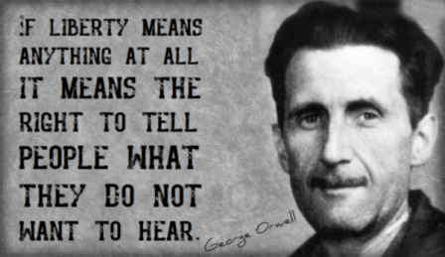
This Lecture
Two new areas
Read pages 221-233
Tests and Guidelines
Start on Context and Content of Speech
Symbolic Speech
United States v. O’Brien (1968)
Texas v. Johnson (1989)

Slide 3
Different tests, different protections
The full Court has never argued for absolute free speech
Higher priority to political speech over others
Traditional public forums versus others
See tests in Table 5-1 (page 222)
We have went over these

Slide 4
Government Interest in Speech Regulation
What are governmental interests?
Express outside the scope of the First Amendment
Violence
Property Damage
Criminal speech
Rights of others violated
Burdens on legitimate governmental functions
Trespass
TPM Restrictions

Slide 5
Restraints on Governmental Power
What are the limits on governmental regulation of speech?
Purpose
Prior Restraint
Content/Viewpoint
Overbreadth
Vagueness
Chilling Effect

Slide 6
Thornhill v. Alabama (1940)
What about speech that goes beyond just words?
When does symbolic speech qualify for First Amendment protection as speech?
Thornhill v. Alabama (1940)
Court by Murphy, J. strikes down an Alabama law that banned labor picketing
Held it must be protected within an area of free discussion

Slide 7
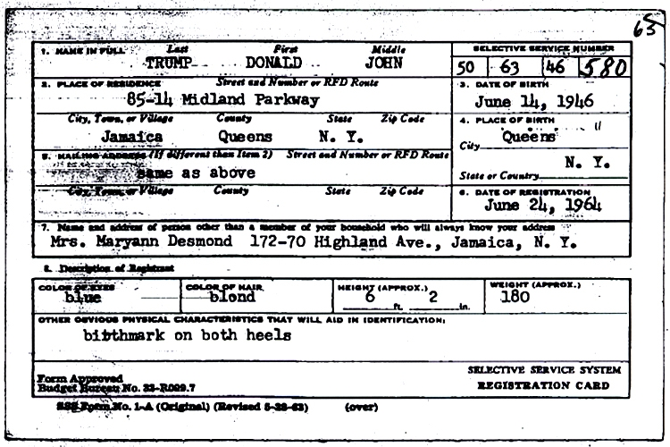
United States v. O’Brien (1968)
Background
A federal law made it illegal to destroy or mutilate a draft card
The defendant/respondent burned his draft card in protest of the Vietnam War
He was convicted, but the 1st Circuit overturned
The federal government appealed

Slide 8
United States v. O’Brien- II
Arguments
For the United States
This is conduct
The Selective Service System requiring this document is valid
This is reasonable congressional action to require possession of the card
For O’Brien
The purpose of the amendment was to quell opposition to the war
This is more analogous to Stromberg v. California
Using the clear and present danger test, the government’s case fails

Slide 9
United States v. O’Brien- III
Warren, C.J. rules for a 7-1 Court (Marshall was recused, Douglas dissented)
The O’Brien Test
1) Is it with the government’s power to regulate under the Constitution?
2) Does it further an important or substantial governmental interest?
IF yes, then…
A) Is the governmental interest unrelated to the suppression of free speech?
B) Is the incidental restriction on the First Amendment no greater than is essential to the furtherance of the interest?
Court finds this law passes all these
Congress has the power to raise an army and this is part of that→ burden placed
The statute in question only prohibits conduct, not speech→ non-communicative

Slide 10
Texas v. Johnson (1989)
Background
There was a protest at the RNC Convention in Dallas in 1984
During the protest, Johnson doused an American flag with kerosene and lit it on fire as the crowd cheered him on
He was charged with flag desecration, and convicted
Sentenced to one year in prison and a $2,000 fine
His conviction was overturned by the Texas Court of Criminal Appeals
The State of Texas appealed that ruling
Most states had laws banning flag desecration at the time

Slide 11
Texas v. Johnson- II
Arguments
For Texas
This is conduct which gets less protection
Statute advances two substantial interests
1) Protection of the flag as a national symbol of nationhood and unity
2) Prevention of breach of peace
This is a valid TPM restriction
For Johnson
This is viewpoint discrimination because others may not see the flag the same way
It is content based discrimination→ based on what may offend some people
His flag burning was an act of political expression

Slide 12
Texas v. Johnson- III
Brennan, J. rules for a 5-4 Court
First question: Was this expressive conduct?
Tinker v. Des Moines- Black armbands in school was speech
Many actions related to the flag are expressive- saluting, displaying a red flag
But not all considered speech
Since this was at a protest, it will be subject to the First Amendment
Does O’Brien apply?
No, the state’s justifications for conviction are not sufficient
It is related to free expression, no breach of peace existed
This amounts to an audience would find it offensive and resort to violence
No fighting words exception

Slide 13
Texas v. Johnson- IV
More from Brennan, J.
State’s assertion in preserving the flag as a symbol of national unity
This puts this case outside of O’Brien because it relates to expressive conduct in treatment of the flag
This shifts things to a stronger level of scrutiny
Government cannot prohibit expression because most find it offensive
There is no separate category for the flag
Founders did not think of this at the time
Better responses than prohibiting speech
Kennedy, J. concurs
Notes the flag protects those that hold it in contempt
Acknowledges that this will be an unpopular decision

Slide 14
Texas v. Johnson- V
Rehnquist, C.J. dissenting, joined by O’Connor and White, JJ.
Says the flag represents an unique role in American society
Johnson had many other ways to protest other than burning a flag, which he could do so in private
First Amendment does not allow for every possible means of communication at all times in all places
Notes the place of the flag for the military and veterans
Stevens, J. dissenting
Also notes the unique symbolism of the flag

Slide 15
Next lecture
We continue in this section
Pages 233-247
Public forums/Preservation of Order
Chaplinsky v. New Hampshire (1942)
Cohen v. California (1971)
McCullen v. Coakley (2014)

