Slide 1
Lecture 21 Chapter 5
Speech Clauses IX
(Freedom of Association)

Slide 2
This Lecture
The End of the Chapter!
Pages 284-292
Freedom of Association
Boy Scouts of American v. Dale (2000)
Ban on gay scouts

Slide 3
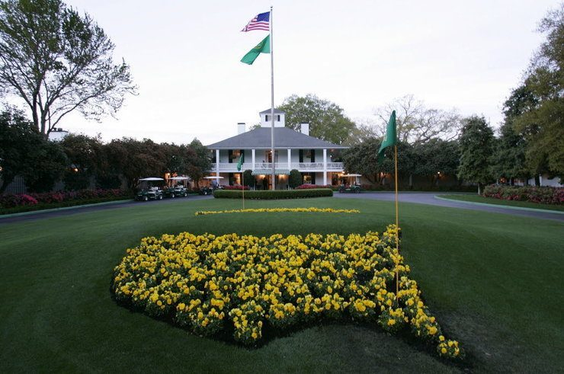
Meaning and Early Cases
What does “Freedom of Association” mean?
Does it mean the right to exclude others from a group?
What about government regulation of a group’s activities?
Are some groups exempt?
The Court had struck down certain regulations on the Communist Party
Albertson v. Subversive Activities Control Board (1968)
Requiring members to register
United States v. Robel (1967)
Penalizing membership (ban on defense plant work)
Aptheker v. Secretary of State (1964)
Taking away rights from members that would not apply to others (passport restriction)

Slide 4
NAACP v. Alabama (1963) NAACP v. Burton (1963)
NAACP v. Alabama (1963)
Struck down an Alabama law to require civil rights groups submit membership logs to the State
NAACP v. Burton (1963)
Law targeting civil rights organizations

Slide 5
Roberts v. United States Jaycees (1984)
Roberts v. United States Jaycees (1984)
The group restricted membership to men ages 18-35
Minnesota said that they violated the state’s anti-gender discrimination law
The Jaycees lose 7-0, by Brennan, J. (Blackmun and Burger recused)
Does not apply equally to all private organizations
Greater protection goes to small, intimate groups, and those expressing sincere ideological or political messages
Large groups with non-political or ideological messages get less protection
They found the Jaycees fell into the latter
Two questions to ask in this framework:
Is the group an expressive one seeking to communicate its views publically or privately?
Does the regulation significantly burden the expression of those viewpoints?

Slide 6
Board of Directors of Rotary International v. Rotary Club of Duarte (1987)
Board of Directors of Rotary International v. Rotary Club of Duarte (1987)
By Powell, J. in a 7-0 ruling (Blackmun and O’Connor recused)
Approved of a California law that applied anti-discrimination laws to Rotary Clubs
They had excluded women
A local club had tried to admit women and had their charter revoked
They found a compelling state interest in preventing sexual discrimination
They also said many activities are held in front of non-members as well

Slide 7
New York State Club Association v. City of New York (1988)
New York State Club Association v. City of New York (1988)
While the Rotary case was going on, New York City had applied its anti-discrimination ordinance to private clubs
Applied to clubs over 400 members
The New York Court of Appeals had unanimously upheld this
The State Club Association appealed and lost
White, J. for a 9-0 Court
“No evidence of any club, let alone a substantial number of clubs, for whom the Law impairs the ability to associate or to advocate public or private viewpoints”
There was little evidence of a burden on this groups since they were more or less public anyway

Slide 8
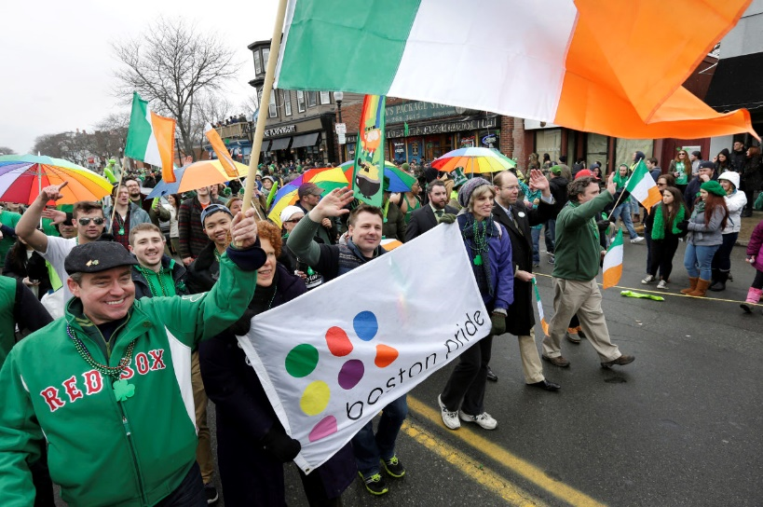
Hurley v. Irish American Gay, Lesbian, and Bisexual Group of Boston (1995)
Hurley v. Irish American Gay, Lesbian, and Bisexual Group of Boston (1995)
The annual St. Patrick’s Day parade in South Boston was organized by a Catholic War Veterans group
They denied the ability of a LBGT group to participate in the parade openly
Massachusetts and other courts said they had to be included due to the state’s non-discrimination laws
The Court, by Souter, J. rules against the LBGT group 9-0
They said it would violate the Council’s rights to be forced to include a group in the parade whose message is counter to the message they wished to convey
They had the right to decide what they wanted to convey, and what not to convey
The Council in 2015 admitted gay groups
This led some conservative Catholic groups to decline to participate

Slide 9
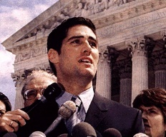
Boy Scouts of American v. Dale (2000)
Background
The Boy Scouts had a rule that barred gay members and scout leaders→
“morally straight” requirement
Dale had been an Eagle Scout and was as an adult a scout leader
He was openly gay and was featured in an article about LBGT teenagers
The BSA rad it and expelled him based on his sexuality
He files a complaint against the BSA based on a New Jersey law preventing discrimination against LBGT people
The BSA said they were not subject to this law
Dale wins in the New Jersey Supreme Court and the BSA appeals
The NJ Supreme Court said the BSA overall goal is inclusion and reaching all eligible youth

Slide 10
Boy Scouts of American v. Dale- II
Arguments
For the Boy Scouts of America
Hurley apples
Dale is essentially violating the moral code of the BSA
The BSA is an intimate association and parents have the right to determine who supervises their children
There is not state interest to justify this application of the law
For Dale
This is a large, national, unselective organization and does not get the protections
This is identity based exclusion not compelling speech
Reinstating him would not change their expressive speech

Slide 11
Boy Scouts of American v. Dale- III
Rehnquist, C.J. rules for a 5-4 Court
Freedom of association also means freedom to not associate
Threshold question→ expressive association
It can be infringed by affecting the group’s ability to advocate private/public viewpoints
This can be overridden if the following shown
A compelling state interest;
Unrelated to the suppression of ideas
Cannot be achieved through means significantly less restrictive of associated freedoms
Associations to do not have to organize with the purpose of disseminating a message

Slide 12
Boy Scouts of American v. Dale- IV
More from Rehnquist, C.J.
The Boy Scouts
They seek to instill certain values by its adult leaders
Scout leaders spend lots of time inculcating these values
This amounts to expressive activity
He says the words “morally straight” and “clean” are open to interpretation
But the BSA says it was meant to be against homosexuality
The Court will go with what they say on this
Allowing Dale to be a leader could send a message the BSA approves of homosexual conduct
The BSA taking a position is sufficient to be expressive
State interest in non-discrimination does not trump the First Amendment restrictions
He goes on to say the Court does not approve or disapprove of the BSA policy

Slide 13
Boy Scouts of American v. Dale- V
Stevens, J. joined by Souter, Ginsburg, and Breyer, JJ. dissenting
They find that does not burden the BSA’s shared goals
Their charter does not permit exclusion
Does not believe “morally straight” or “clean” directly refers to homosexuality
The BSA directs that sexual education be at home
The right to associate is not a right to discriminate
He seems to imply the decision and policy based on prejudice

Slide 14
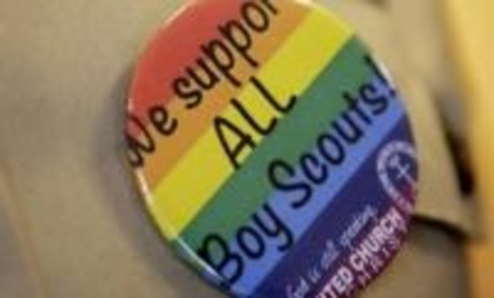
Aftermath
The Boy Scouts eventually
2014→ allowed gay boy scouts
2015→ ended the nationwide ban on gay scout leaders
Local troops can still ban them

Slide 15
Next Lecture
We move to Freedom of the Press
Chapter 6
Pages 293-309
Prior Restraint
Near v. Minnesota (1931)
New York Times v. United States (1971)
Hazelwood School District v. Kuhlmeier (1988)

