Slide 1
Lecture 23 Chapter 6
Freedom of the Press II
(Control of Content; News Gathering)

Slide 2
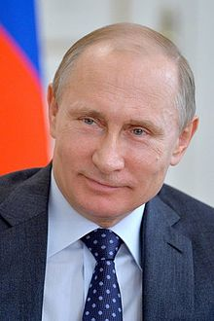
This Lecture
More on Freedom of the Press
Pages 309-320
Government Control of Content
News Gathering
Branzburg v. Hayes (1972)

Slide 3
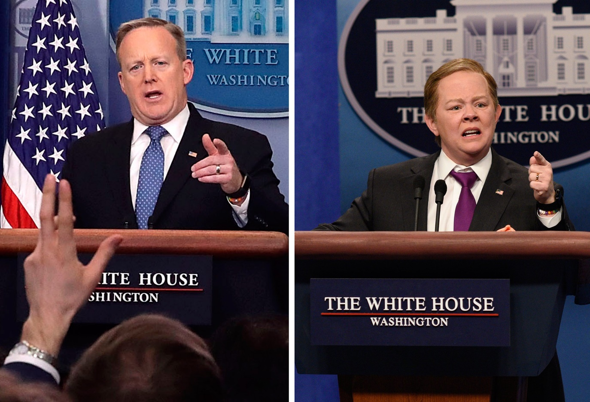
Governmental Control of Press Content
Can government try to control content?
Inclusion or exclusion?

Slide 4
Prohibiting Content
Cox Broadcasting Corporation v. Cohn (1975)
Challenge to a Georgia law making it illegal to publish rape victim names
A reporter found Cohn’s name in public documents and revealed it on air
She sued the company
Court rules against her because they are public records
Criminal matters are of public concern
Nebraska Press Association v. Stuart (1976)
Court did not allow a gag order to stand to protect a defendant from pretrial publicity
Smith v. Daily Mail Publishing Company (1979)
Court strikes down a law prohibiting the publication of names of juvenile offenders

Slide 5
Mandating Content
Miami Herald v. Tornillo (1974)
Challenge to a Florida law mandating that a newspaper to publish articles by a candidate when that newspaper criticized that candidate
The Miami Herald refused to comply
Court unanimously, by Burger, C.J. for the newspaper
Hands off newspapers
This was a penalty based on content

Slide 6
Regulating other media
Red Lion Broadcasting v. FCC (1969)
The FCC controls broadcast licenses and stations must comply or can be revoked
Challenge to the Fairness Doctrine
The Court rules for the FCC finding that Congress has a greater role to regulate since there are only a limited number of broadcast stations
Broadcast media has less protection than print media
FCC v. Pacifica Foundation (1978)
Broadcast media gets the least protection
FCC v. Fox Stations (2009)
Court upheld the FCC treating all expletives as a single incident
Reno v. ACLU (1997)
Internet gets greater protections

Slide 7
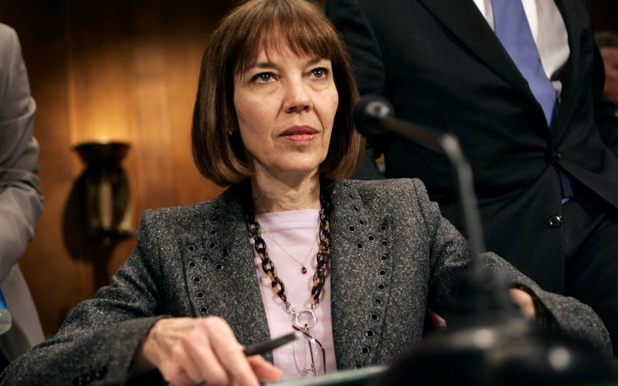
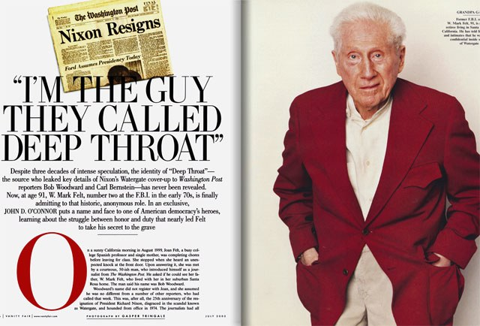
Reporters’ Privilege
Can a reporter be forced to testify or give up a source?
The way it usually works is that a judge will hold the reporter in contempt of Court
If reporters have to give up sources, it may mean less will tell them things
One solution→ federal and state shield laws

Slide 8
Branzburg v. Hayes (1972)
Background
Branzburg was a reporter for the Louisville Courier-Journal
He wrote articles about persons synthesizing hashish and using marijuana
He was subpoenaed to testify in a Franklin County grand jury
He refused to answer questions about his sources
He filed legal action to stop him from being questioned on his sources
His claims were denied in Kentucky and he appealed

Slide 9
Branzburg v. Hayes- II
Arguments
For Branzburg
Not granting reporters privilege would violate the First Amendment
For compelling testimony, there must be a heavy burden on the government
For Judge Hayes (Franklin Circuit Court)
Reporter’s privilege is not part of the First Amendment
Reporters are no different than ordinary citizens

Slide 10
Branzburg v. Hayes- III
White, J. for a 5-4 Court
Reporter’s privilege is not part of the First Amendment
Reporters have no special rights
No compelling state interest
No prior restraints, restrictions on what the press could publish or commands to publish
It is up to lawmakers to determine who gets privilege

Slide 11
Branzburg v. Hayes- IV
Douglas, J. dissenting
This will have bad effects
Less sources will reveal information
Editors will be more nervous about what they publish
Stewart, J. dissenting, joined by Marshall and Brennan, JJ.
This will impair the important role of the press
Long term will hurt the administration of justice
Press the investigative arm against government

Slide 12
Branzburg v. Hayes- V
Stewart, J. dissenting, joined by Marshall and Brennan, JJ.
This will impair the important role of the press
Court has a “crabbed view of the First Amendment”
Long term will hurt the administration of justice
Press the investigative arm against government
He would have a three part test for privilege

Slide 13
Zurcher v. Stanford Daily (1978)
Zurcher v. Stanford Daily (1978)
Student newspaper case
Police wanted their photos
They got a warrant and searched
The newspaper sued
Court rules for the state
White, J. says the press is not above the law

Slide 14
Right to Access
Houchins v. KQED (1978)
Could reporters have special access to jails beyond what others have?
Burger, C.J. for a 4-3 Court (3 member plurality)
No, the media and government have special functions
Richmond Newspapers v. Virginia (1980)
A court could not deny access of the press to a murder trial
There is an inherent right to listen in the First Amendment

Slide 15
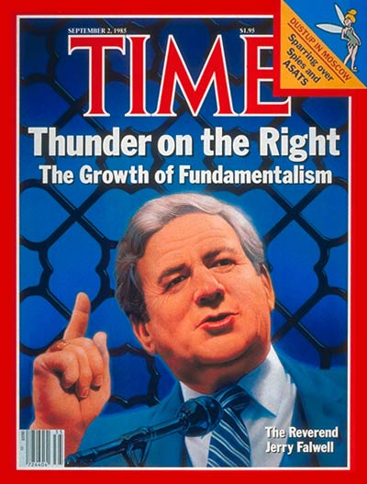
Next Lecture
Moving to Boundaries of Free Expression
Pages 321-335
Libel
New York Times v. Sullivan (1964)
Hustler Magazine v. Falwell (1988)

