Slide 1
Lecture 25 The Commerce Power
Part 2: Industrial Revolution Cases I

Slide 2
This lecture
We will cover the mater on attempts to define the commerce power in the wake of the Industrial Revolution
Pages 422-431

Slide 3
The post Civil War economy
Changes in the economy
Country goes from mostly very small businesses that operate in small areas to large interstate corporations
These included railroads and pipelines which went across state lines
This also led to big businesses that turned into monopolies
They often exploited workers- which eventually led to unions
Low wages, no benefits, and workplace deaths were common
They often employed children at low wages
Congress sought to regulate some of these practices
Through their commerce power as a federal police power
Critics attacked this as exceeding its commerce power

Slide 4
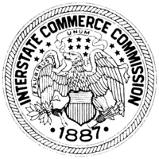
Defining the Commerce Power
The Court seemed to take a dim view on Congress having this much power under the Commerce Clause
Two major pieces of legislation
The Interstate Commerce Act of 1887- railroad regulation
The Sherman Anti-Trust Act of 1890- designed to break up monopolies
Big business challenged them as they were intrastate commerce regulation, not interstate
Deciding what was interstate versus intrastate was not that easy

Slide 5
Manufacturing and its Relationship to Interstate Commerce
Many industries had become uncompetitive
Monopolies or trusts
Steel, oil, meatpacking, sugar
“restraint of trade”
Veazie v. Moor (1853)- Interstate commerce power did not extend to manufacturing
Kidd v. Pearson (1888)
An Iowa law prohibited the production of alcoholic beverages in the state
It was challenged by saying it could be shipped out of state, so it was unconstitutional
They do not include manufacturing
They seem to limit it to buying, selling, and transportation

Slide 6
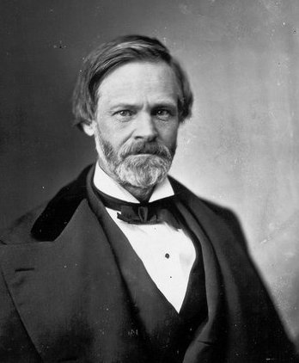
United States v. E.C. Knight Co. (1895)
United States v. E.C. Knight Co. (1895)
Background
The American Sugar Refining Company controlled 65% of the refining capacity nationwide
Four Pennsylvania refiners had another 33%
The company sought to buy out the Pennsylvania refiners, including E.C. Knight Company
This would give it 98% of the sugar market
The federal government sued to block the sale as a monopoly in restraint of trade
Under the Sherman Anti-Trust Act
Some say the Attorney General threw the case

Slide 7
United States v. E.C. Knight Co.- II
Question: Did Congress go beyond its powers to regulate interstate commerce with the Sherman Anti-Trust Act?
Arguments
For the United States (don’t allow the sale
Sugar must be shipped in interstate commerce
The products are sold and distributed across all the states- they were engaged in trade
For E.C. Knight (allow the sale)
The commerce power does not extend to manufacturing
Even if they are intended to be sold out of state later
It only apples to contracts to buy, sell, exchange goods and their transportation
To keep the products in one state would be a restraint of trade

Slide 8
United States v. E.C. Knight Co.- III
Chief Justice Fuller writes for a 8-1 Court
He agrees with E.C. Knight
The intent of the manufacturer as far as where the good goes is of no matter
Manufacturing is not commerce, so this sale is not subject to the Sherman Act
However, the Sherman Act is constitutional when it seeks to break up trusts when it does involve interstate commerce, but it doesn’t apply here
However, this acted to neuter large parts of the law
“Doubtless the power to control the manufacture of a given thing involves in a certain sense the control of its disposition, but . . . affects it only incidentally and indirectly.”
He rejects the “any effect on interstate commerce” approach
There must be a direct effect

Slide 9
United States v. E.C. Knight Co.- II
Justice Harlan, dissenting
This is an additional Justice Harlan
He takes the opposite view
He does not see how state sovereignty hurt by this particular regulation
States could not break up these trusts either
Because the goods are being transported between states
Therefore, only the federal government could do this and they are being told no
He does not like monopolies- they distort the markets
He would have allowed it

Slide 10
Regulation of Railroads- The Shreveport Doctrine- I
This did not mean the Court closed off all challenges to monopolies
They allowed quite a bit in the area of transportation
So railroads- the primary means for transporting goods in the country at the time
Northern Securities Company v. United States (1904)
They had allowed regulation of interstate sale of pipe before in Addyson Pipe and Steel Company v. United States (1899)
Here, they blocked a railroad merger

Slide 11
Regulation of Railroads- The Shreveport Doctrine- II
More on the Shreveport Doctrine
Houston, E & W Texas Railway Company v. United States (1914)
The company served three cities- Houston, Dallas, and Shreveport
The intrastate lines were regulated by Texas, and the one to Shreveport by the ICC
The rates by the Texas Railroad Commission were lower than the ICC
This was to discourage business being done in Louisiana
The ICC ordered the Texas Railroad Commission to match the ICC rates
Chief Justice Hughes writes for a 7-2 Court
The Commerce power extended to "matters having such a close and substantial relation to interstate traffic”- it is immaterial that intrastate rates are involved here
So Congress can regulate when failure to do so would cripple, retard or destroy interstate commerce

Slide 12
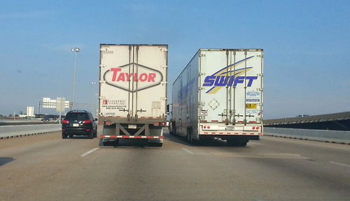
Stream of Commerce Doctrine
These cases deal with meatpacking
A few companies had gained control of the stockyards
They were forcing farmers and ranchers to accept unreasonably low prices
Swift & Company v. United States (1905)
Justice Holmes writes for a unanimous court that it applies to the stockyards
The commercial sale of beef begins when the cattle leave the range to the final sale
Stream of commerce means that the federal government can regulate from the point of its origin to the point of termination
This was distinguished from manufacturing

Slide 13
Stafford v. Wallace (1922)
Stafford v. Wallace (1922)
Background
Congress decides to go further in regulating the meatpacking industry with the Packers and Stockyards Act of 1921
It prohibited any unfair, discriminatory, or deceptive practices
Stockyard dealer and commission men had to register with the Secretary of Agriculture
The Secretary of Agriculture had wide authority to make rules and regulations, including the setting of rates and record keeping
Question: Did Congress have the authority under the Commerce Clause to enforce this particular law?

Slide 14
Stafford v. Wallace- II
Arguments
For Stafford (strike down the law)
The dealers are not engaged in interstate commerce within the stockyards
Their dealings are wholly within the state
Transportation ceases when it reaches the stockyards
This would mean Congress could also regulate those feed the cattle, so on
For the United States (uphold the law)
This is part of the instrumentalities of commerce
The question should be whether Congress could designate them and their transactions as part of the current of commerce- and the answer is yes

Slide 15
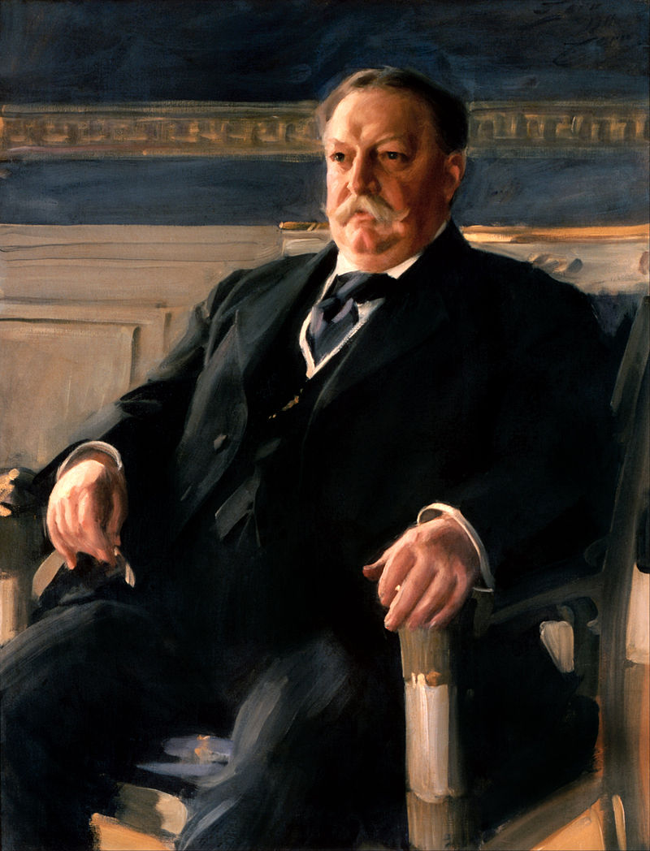
Stafford v. Wallace- III
Chief Justice Taft writes for a 7-1 Court
Taft is worried of the consequences of monopolies
Lower prices to the ranchers, higher prices to consumers
As President Taft had continued TR’s anti-trust policies and did some of his own- US Steel
The stockyards are not the final destination
The commission men and dealers do not stop the flow, but are part of it
The goal of this act is to promote the flow of commerce
The federal government gets another win
Chicago Board of Trade v. Olson (1923)
Bringing in grain exchanges was permitted as well

Slide 16
Next Lecture
We will finish up on the Industrial Revolution cases regarding interstate commerce, and focus on it as a federal police power
Pages 431-439

