Slide 1
Chapter 2
The Judiciary
Part I: Judicial Review

Slide 2
Chapter 2- Judicial Revew
This will cover pages 47-86.
I have covered a lot of pages 47-61 in the previous lecture, but we will review a few things
However, most of the cases we will talk about start on Page 61.
A lot of the theme of this chapter is when will the Supreme Court decide to get involved in certain disputes (or not).

Slide 3
Major Cases in this Chapter
Marbury v. Madison (1803)
Martin v. Hunter’s Lessee (1816)
Eakin v. Raub (Penn. 1825), Gibson, J. dissenting- Skim only
Ex Parte McCardle (1869)
Baker v. Carr (1962)
Nixon v. United States (1993)
Flast v. Cohen (1968)
Hollingsworth v. Perry (2013)
Evenwel v. Abbott (2016)- this is a recent case and not yet in the book

Slide 4
Marbury v. Madison (1803)
This is the considered one the most important cases in all of constitutional law
It stands for the proposition that the Court can review acts of Congress
Facts/background of the case
Jefferson defeats Madison in the 1800 election, and the Jeffersonian Republicans won a big Senate majority
However, Presidents and the new Congress at that time did not take office until March 4
The period between the election and the new President and Congress taking office is known as the “lame duck” period
Adams and his party pushed through over 200 nominations, including 16 judges, and a new Chief Justice- John Marshall- a close Adams’ ally

Slide 5
Marbury v. Madison- II
When Marshall became Chief Justice, he was also Secretary of State
The Federalists had authorized new Justices of the Peace in D.C.
Marshall forgot to deliver some of the commissions
The new Secretary of State James Madison and President Jefferson refused to deliver the commissions
Marbury wanted his commission so he took the issue to the Supreme Court for a writ of mandamus under Section 13 of the Judiciary Act of 1789
The Jefferson Administration had abolished the JOP Court in question in 1802
Notice that even though Marshall had a stake in the case, he failed to recuse himself?
Recusal is up to the justices themselves

Slide 6
Marbury v. Madison- III
The Court had actually reviewed the constitutionality of statute before in Hylton v. United States (1796)- it involved whether Congress had the authority to tax carriages
Hamilton argued in favor of judicial review in Federalist #78
Marshall has to be cautious
Jefferson may ignore any decision
There might be impeachment efforts against him and others

Slide 7
Marbury v. Madison- IV
The questions they have to answer (at 154)
1. Has the applicant a right to the commission he demands?
Yes, the President can appoint who he wants
Everything was legal in the commission
There was no legal reason to withhold the commission
2. If he has a right, and that right has been violated, do the laws of his country afford him a remedy?
Yes, for the refusal to deliver the commission

Slide 8
Marbury v. Madison- V
3. If they do afford him a remedy, is it a mandamus issuing from this court?
No, the part of the Judiciary Act of 1789 that created original jurisdiction in the Supreme Court to issue a writ of mandamus was unconstitutional
Congress had no authority to create any additional type of original jurisdiction cases
Note they said that Congress could not add- remember this when we look at U.S. Term Limits v. Thornton in the next section
Thus, the Court established that it would had the right to review statutes to determine if they were constitutional

Slide 9
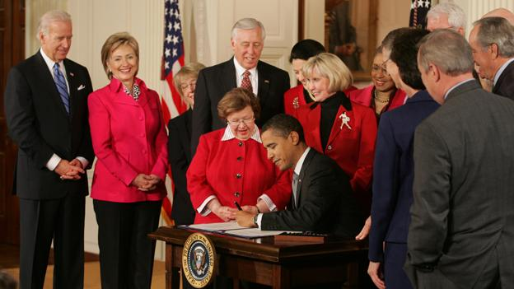
City of Boerne v. Flores (1997)
City of Boerne v. Flores (1997)- Congress cannot dictate to the Court what precedent to follow
FRFA case trying to overturn previous precedent
Congress had also tried to legislatively overturn Miranda v. Arizona (1966)
Congress could not do this- Dickerson v. United States (2000)
Congress can overturn a Court ruling when it deals with statutory interpretation
Ledbetter v. Goodyear Tire (2007)
Lilly Ledbetter Act overturned this case, which dealt with when a the statute of limitation starts on equal pay lawsuits
First law signed by President Obama in 2009

Slide 10
Martin v. Hunter’s Lessee (1816)
But can the U.S. Supreme Court review individual state court decisions?
Which Court is superior?
The U.S. Supreme Court trumps all other courts
History
A loyalist had lots of property in Virginia during the Revolutionary War
He died and left it to his nephew
Virginia law said loyalists could not inherit land
Virginia confiscated the land and sold tracts off
Chief Justice Marshall recused himself
The Court heard the case in 1813 and sided against Virginia
Virginia law conflicted with the 1783 Treaty of Paris
Virginia Supreme Court said it was not subordinate to US Supreme Court
Virginia Supreme Court declared part of the Judiciary Act of 1789 unconstitutional

Slide 11
Martin v. Hunter’s Lessee- II
Who can interpret federal law?
Can the federal courts exercise appellate jurisdiction over state courts?
State sovereignty?
“Appellate jurisdiction is given by the constitution in all cases where it has not original jurisdiction”
Judicial power shall extend to all cases
If appellate jurisdiction is concurrent, then the appellate jurisdiction of the United States might have no real existence
“The courts of the United States can, without question, revise the proceedings of the executive and legislative authorities of the states, and if they are found to be contrary to the constitution, may declare them of no legal validity”.
Uniformity of decisions across the United States
Hence, the reason for taking cases today with split circuits!

Slide 12
More on Federal Courts vs. State Courts
Cohens v. Virginia (1821)
“The constitution and laws of a state, so far as they are repugnant to the constitution and laws of the United States, are absolutely void”
States subordinate to federal government in this realm
Mourdock v. City of Memphis (1875)
Federal courts will not get involved in interpretation of state constitutional and legislative provisions
1988 Laws- Supreme Court no longer obligated to review state court decisions involving federal law.
Eakin v. Raub (Penn. 1825), Gibson, J. dissenting
Judicial self-restraint
Judiciary not necessarily the arbiter of constitutional disputes
Leave it to the political process to sort things out
Court seeking not to be a “Super-Legislature”

Slide 13
Other Considerations
Self-Restraint
Some say the Courts should not get involved in disputes between branches
Deference
Is this tied to politics?
Do we have both liberal and conservative activism?
Democratic Checks
Decisions can be overturned by Consitutional Amendment
Only four times- 11th (sovereign immunity- Chisholm v. Georgia), 16th (income tax- Pollack v. Farmers’ Loan and Trust), 19th (women the right to vote- Minor v. Happersett), 26th (18 year old vote- Oregon v. Mitchell)
Many others have been proposed- school prayer, campaign finance, abortion, flag burning

Slide 14
More Considerations
Judicial Supremacy
Only (?) the courts get to decide how to interpret the Constitution
Public opinion
Anti-New Deal Court
Justice Owen switches his vote in West Coast Hotel v. Parrish (1937)
Reinstatement of the death penalty
Roe v. Wade (1973) and its effect on abortion opinions
Protection of minority rights
But which minorities?
Helping the privileged instead of the oppressed

