Slide 1
Lecture 30 Chapter 10
The Right to Privacy II
Abortion Rights I

Slide 2
This Lecture
Chapter 10
401-413
The Right to Abortion I
Roe v. Wade (1973)
We will cover abortion rights up to the entrance of Sandra Day O’Connor to the Court

Slide 3
The State of Abortion before Roe
Before Roe, few states allowed most abortions to be performed
The majority did not even allow exceptions for rape/incest, life of the mother, or deformity
It was a crime to perform or obtain an abortion
Many obtained illegal abortions or self-induced
Large numbers of deaths
Some traveled to New York or even to other countries

Slide 4
Eisenstadt v. Baird (1972)
Eisenstadt v. Baird (1972)
Brennan, J. for a 6-1 Court (Powell and Rehnquist not on the Court long enough)
Burger, C.J. dissenting
Struck down a law banning the sale of contraceptives to single people
Violated their rights, not just of married ones as in Griswold
If the right of privacy means anything, it is the right of the individual, married or single, to be free from unwarranted governmental intrusion into matters so fundamentally affecting a person as the decision whether to bear or beget a child.“
Also, since Griswold, civil liberty and women’s groups began to push the legal theory that the right to privacy included the right to obtain an abortion
Would be a fundamental right
States would not be able to justify a compelling state interest to ban the procedure
This led to a lot of challenges to abortion laws to test this proposition

Slide 5
Roe v. Wade (1973)
Background I
Challenge to a Texas abortion law that banned all abortions except to save the life of the mother
Plaintiff here was Norma McCorvey, a 21 year old women who had claimed she was raped
It turned out she lied about that
This was in 1969→ two female attorneys challenged the law
They won at the district, and circuit level but do not get an injunction against the law
On 9th Amendment grounds
They were then able to able to the Supreme Court (both sides cross appealed)
The pro-choice side said this was a fundamental right, thus subject to strict scrutiny→ risks associated with restrictive abortion laws
Texas said the compelling state interest was protection of human life

Slide 6
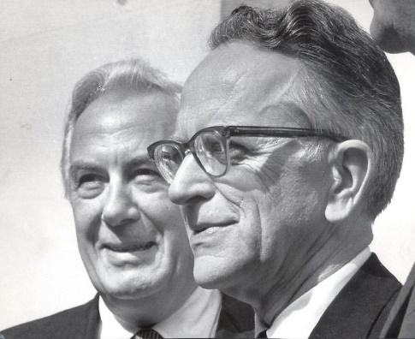
Roe v. Wade- II
Background II
The case was argued initially before only 7 justices
A majority were in favor of striking down the laws
Burger assigned the opinion to Blackmun
Brennan and Douglas objected to this on seniority grounds
They wanted to go further than Blackmun→ vagueness
Blackmun seemed to be brought around it being more of a right in Doe
On privacy and women’s rights grounds
Burger then got the case reargued with Powell and Rehnquist joining the Court
It was ordered re-argued by a 5-4 vote before the opinion of Blackmun could be issued

Slide 7
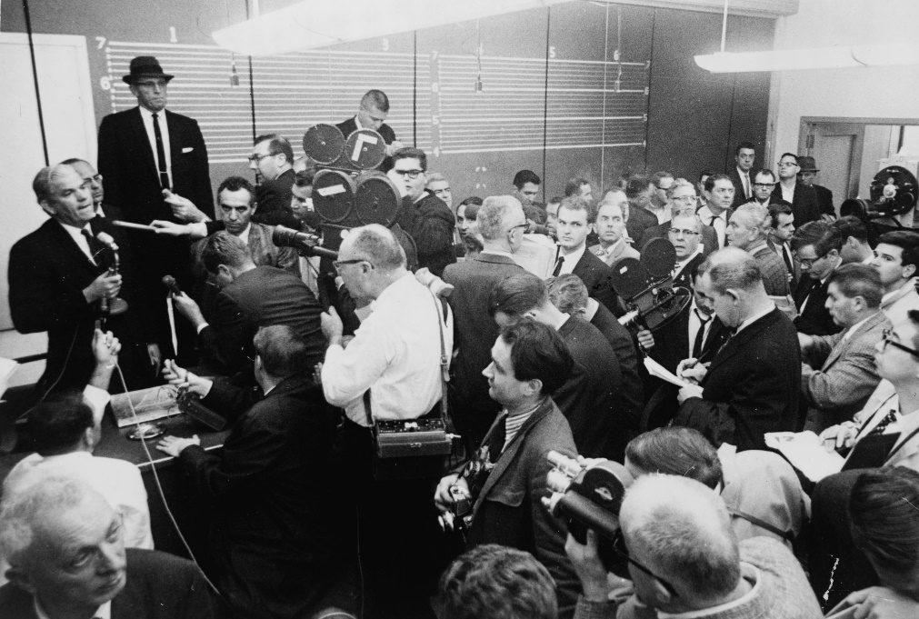
Roe v. Wade- III
Arguments
For Roe
This is a fundamental personal right secured by the right to privacy
Any state interest is in regulating private sexual conduct
Not public health or protection of human life
For Wade (Texas)
There is no right to an abortion in the Constitution
Personal/marital privacy rights are not absolute
Life begins at conception, making it a compelling state interest to save the life of the fetus even if it goes against the rights of the women

Slide 8
Roe v. Wade- IV
Blackmun, J. for a 7-2 Court
Burger, C.J., Douglas, J. and Stewart, J. had concurring opinions, but signed off on this majority opinion
Looks at the history of reasons for the laws
Victorian sexual morals→ discourage illicit sexual conduct
Abortion was once a very dangerous procedure for the woman, but now is not
Blackmun had spent a week during the 1972 recess at the Mayo Clinic looking into this
State interest in protecting prenatal life
Starts from the proposition that all life begins at conception, thus the only way to justify an abortion would be that interferes with the mother’s life
Key points of case
Abortion right fundamental
Strict Scrutiny applied
Trimester framework

Slide 9
Roe v. Wade- V
More from Blackmun, J.
He talks about the right to privacy
Note that he hedges on where the right comes from but says it exists
And then says it applies to the right to of a woman to decide whether or not to terminate a pregnancy
May lead to stress on the mother to carry to term→ psychological, unwed mother stigma, financial
Court finds this primarily a medical procedure
However, he says the right is not absolute to all times in a pregnancy
It is on a scale from conception to birth timeline
They do not answer when life begins question
The state does have more interest as the pregnancy progresses

Slide 10
Roe v. Wade- VI
More from Blackmun, J.
Examples of legitimate state regulations
Requirements as to who can perform the abortion (licensure)
The type or location of the facility
The state’s interests come into play at viability—trimester framework
First trimester→ leave up to doctor and women
Sometime after the end of the first trimester→ legitimate to regulate for maternal health
After viability→ state interest highest, may regulate or even ban except when the mother’s life or health at stake

Slide 11
Roe v. Wade- VII
Rehnquist, J. dissenting
Does not believe this involves the right to privacy
He isn’t exactly sold on privacy as a right to start with
He would apply a rational basis review to abortion regulations
Instead of compelling state interest test, this would lead to most being upheld
He notes that using this test means most regulations will fall and the Court will place its judgment over those of lawmakers
These statutes were valid when the 14th Amendment was adopted so they should be considered valid now
Questions when abortion should be found to be a fundamental right

Slide 12
Roe v. Wade- VIII
White, J. dissenting, joined by Rehnquist, J.
Finds no constitutional basis for the ruling
Ruling overrides most state laws on abortion
Takes away their ability to legislate on the issue of abortion
State cannot weight the importance of the rights of the fetus
Interposes a constitutional barrier to state efforts to protect human life
Gives a right to mothers and doctors to terminate it
This is “raw judicial power”
Judicial restraint argument
Let the people decide the issues in the states
He switches from Griswold while Burger, C.J. switches the other way

Slide 13
After Roe
What regulations are allowed?
While states could not ban abortion, many tried to severely restrict it
Court will hear many cases on this
What about the political reaction?
Large opposition initially was from Roman Catholics
Then joined by Protestant Evangelicals
The parties eventually split by this issue

Slide 14
Planned Parenthood v. Danforth (1976)
Planned Parenthood v. Danforth (1976)
Blackmun, J. for a 6-3 Court
Challenge to a broad Missouri law regulating abortion
Court strikes down parental consent and spousal consent provisions
Left open some parental consent laws
Judicial bypass
Ayotte v. Planned Parenthood of Northern New England (2006)→ upheld a parental notification law with a judicial bypass and exceptions for life/health of the minor
These provisions applied to the first trimester
The seemed to say that no regulations were going to be allowed then
They did uphold a provision requiring the woman to sign a document saying that she had not been coerced

Slide 15
Harris v. McCrae (1980)
Harris v. McCrae (1980)
Issue of the Hyde Amendment which limited federal abortion funding
Challenged on violating the right to privacy, equal protection for poor women and Establishment Clause
Court rejects all three by a 5-4 vote (Powell and Stewart switch from Roe)
Does not carry a constitutional entitlement to funding of that right
Key is not to create any new obstacles
Being unable to afford not one of those

Slide 16
Next Lecture
Chapter 10
More on Abortion Rights
Pages 413-427
The Right to Abortion II
Planned Parenthood of SE Pennsylvania v. Casey (1992)
Partial birth abortion laws
Whole Women’s Health v. Hellerstedt (2017)

