Slide 1
Lecture 32 The Commerce Power
Part 9: Commerce Power of States I

Slide 2
This lecture
The is the penultimate lecture in this chapter
Doctrine of State Exclusiveness
Dormant Commerce Clause
State burdens on interstate commerce
Pages 501-510

Slide 3
Commerce Power to the States
The states have commerce power too
We have been looking at the limits of Congress to regulate interstate commerce
Now we look at limits on states regulating commerce as well
Things totally within a state or not affecting other states→ state regulation
But did the line of cases after Jones and Laughlin take away all state powers?
The answer is no

Slide 4
Doctrine of State Exclusiveness
Wilson v. Black-Bird Creek Marsh Company (1829)
A Delaware law authorized a dam to be built to stop water from entering a marsh
Wilson had a steamship and said it would stop his business
His ship rammed the dam on purpose
Wilson appealed a judgment against him saying that only Congress could pass a law permitting the obstruction of a navigable stream
The Court, by Marshall, rules against him
He said Congress, but not acting on the issue left it open for the state to regulate
But if Congress did act, the statute could be void

Slide 5
Early Cases on State Exclusiveness
Taney was more sympathetic to states rights
Mayor of New York v. Miln (1837)
Involved a challenge to the New York Passenger Act of 1824 to keep out indigent foreigners
Ship captains had to provide the mayor with a detailed list on all passengers or face fines
Passengers who were refused entry would be sent back at the ship owner’s expense
A fined ship owner appealed saying that this was reserved to the federal government to regulate foreign commerce
The Court ruled for New York on the grounds that this was part of its police powers for the well being of its citizens→ that power is complete and unqualified
They say that Congress had failed to regulate as well

Slide 6
License Cases and Passenger Cases
The License Cases (1847)
Several states passed laws to tax and license alcohol
Whether it be domestic or foreign
It was upheld as a proper police power
The Passenger Cases (1849)
This was also about keeping out indigent foreigners
Each ship had to pay a head tax→ to fund types of public assistance
The Court rules 5-4 against the states→ laws were in conflict with Congress ability to regulate foreign commerce
The dissenters, led by Taney said it was a valid use of police powers to protect the state’s citizens from indigent and sick immigrants
However, no opinion here commanded a majority of justices

Slide 7
Cooley v. Board of Wardens (1852)
Cooley v. Board of Wardens (1852)
Background
Pennsylvania had a law requiring all vessels that entered the Port of Philadelphia to hire a local pilot to guide the ships in and out of that Port
Those that did not comply were fined
The fines went to a fund for distressed or decayed pilots, their widows and children
Cooley sailed his vessel into the Philadelphia without a local pilot and was fined
Question
Did this law violate the Commerce Clause?

Slide 8
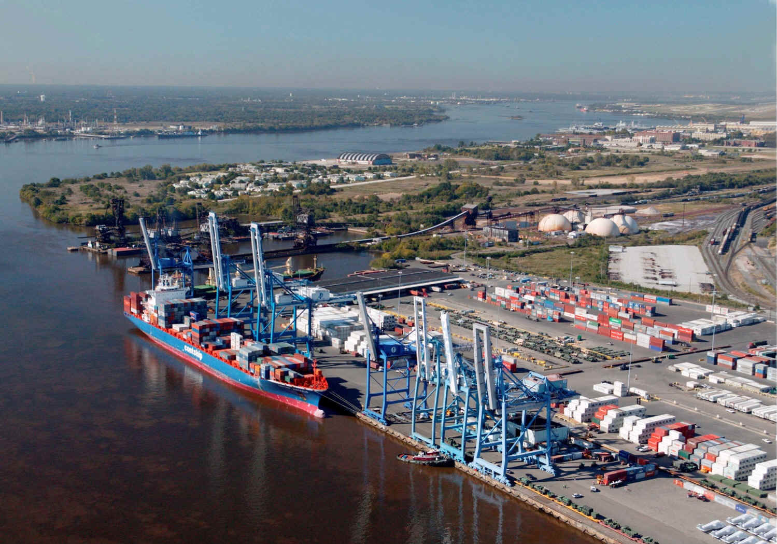
Cooley v. Board of Wardens- II
Arguments
For Cooley (strike down the law)
The power to regulate interstate and foreign commerce is exclusive to Congress
Regulation of navigation are regulations of commerce, thus jurisdiction of Congress
Congress can also not confer this power on states either
For Board of Wardens of the Port of Philadelphia (uphold the law)
This does not regulate commerce
It is more an exercise of police powers by the state
This is designed to aid, not regulate commerce
The power to regulate commerce is not exclusive
If Congress has passed no conflicting laws, a state law is valid

Slide 9
Cooley v. Board of Wardens- III
Justice Curtis writes for a 7-2 Court
The Court upholds the law
Early U.S. law made this a concurrent power
Some things require uniformity and some can allow for local conditions
The mere grant of authority to Congress to regulate interstate commerce did not deprive states the right to regulate pilots
Thus this grant of authority is selective

Slide 10
Cooley v. Board of Wardens- IV
So how far can states go in regulating commerce
Purely intrastate commerce
Congress can regulate interstate and foreign commerce, and when it exercises this power, state laws are preempted
Power of Congress to regulate interstate and foreign commerce is exclusive over elements that require uniformity or national in scope
Those that do not and have not been regulated by Congress may be subject to state authority, including under its police powers

Slide 11
The Dormant Commerce Clause
When are states prohibited from regulation?
The Commerce Clause is both an affirmative grant of power and a negative sweep of power as well
So states are prohibited from regulating in ways detrimental to the national economy
Those regulations must not negatively and unreasonably affect interstate commerce
South Carolina State Highway Department v. Barnwell Brothers (1938)
South Carolina passed a very strict trucking law for width and weight
Nearly all interstate trucks exceeded this- only four other states had limits this low
The Court upheld the law
Regulating state highways is of local concern, even if it did burden interstate commerce
Congress chose not to act on a national standard
It applied equally to interstate and intrastate trucks

Slide 12
Southern Pacific Company v. Arizona (1945)
Southern Pacific Company v. Arizona (1945)
Background
Arizona in 1912 passes the Train Limit Act, limiting the number of cars in a train
South Pacific said the law was conflicting with the commerce clause
The Company won at the trial Court
The Arizona Supreme Court reversed, saying that Congress had not yet acted on this
They said that this was a public safety law
Question:
Did this law place an unconstitutional burden on interstate commerce?

Slide 13
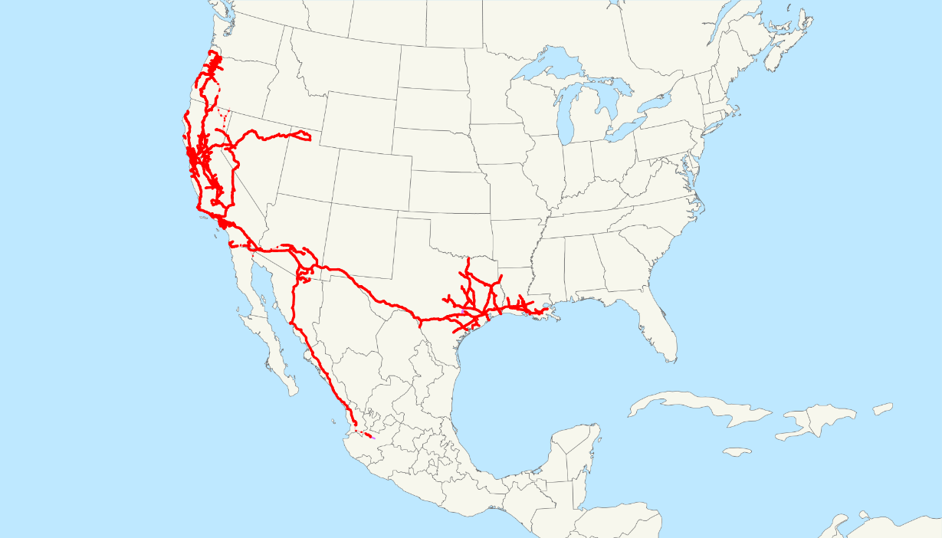
Southern Pacific Company v. Arizona- II
Arguments
For South Pacific (law unconstitutional)
This is a matter of national concern and national standards are needed
This imposes a serious burden on interstate commerce by hindering efficient train service
Previous law says Congress has occupied the field, even by silence or inaction
For the State of Arizona (uphold the law)
This is for the safety and protection of Arizona citizens
Congress has not yet intervened, so it has not occupied the field
Whether this law imposes a impermissible burden on interstate commerce is a question for Congress and not the courts
The burden is not as substantial as the company says it is

Slide 14
Southern Pacific Company v. Arizona- III
Chief Justice Stone writes for a 7-2 Court
In the absence of conflicting legislation leaves a residuum to states
States can regulate in areas of local concern
Chains on tires in snowy areas?
But they cannot impede substantially the free flow of commerce or things that need national uniformity
In this case, most all trains in the country exceed this limits
Nearly all train traffic through Arizona is interstate
More sets of trains means higher costs
This clearly burdens interstate traffic of goods by train
This requires national uniformity→ remember this was before the interstate highway system and most of the modern trucking industry→ this is the way most goods moved

Slide 15
Southern Pacific Company v. Arizona- IV
A couple of dissents
Black, J. dissenting
This should be left to the political process
Congress should make the law not the courts
Douglas, J. dissenting
Courts should intervene only when state legislation discriminated against interstate commerce or it was out of harmony with laws enacted by Congress
The Interstate Commerce Commission already has broad authority and powers

Slide 16
Next lecture
We FINALLY finish the chapter on the Commerce Clause
Finish the Dormant Commerce Clause
Pages 510-520

