Slide 1
Lecture 33 Chapter 10
The Right to Privacy V
Gay Rights I

Slide 2
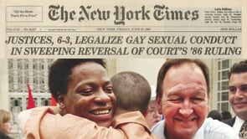
This Lecture
Chapter 10
We move to gay rights
What rights do LGBT persons have in their own privacy?
This time private sexual activity
Lawrence v. Texas (2003)
Pages 427-437

Slide 3
When can….
When can government regulate sexual activity?
We know they can in cases of
Non consensual activities (rape, force, groping)
Which can occur inside a marriage too
Between adults and minors (child molesting, sexual misconduct with a minor)
And possession of child pornography
Bestiality (sex between humans and animals)
Polygamy (plural marriage)
Prostitution (sex in exchange for money→ legal in parts of Nevada)
Some pornography, including child pornography
Public nudity

Slide 4
But then…
What about?
Most consensual sexual activity between consenting adults?
Adultery
What is the age of consent?
Sex between unmarried couples
Sex between persons of the same sex
Some particular sex acts (anal and oral sex→ many states had these laws)
Prohibiting marriage between same sex couples
Possession of adult pornography (Stanley v. Georgia (1969))
Does the right to privacy extend to these things?

Slide 5
Bowers v. Hardwick (1986)
Bowers v. Hardwick (1986)
Case from Atlanta, Georgia
An officer entered Hardwick’s home to serve a warrant for failure to appear
It turns out the warrant was invalid due to a clerical error
His roommate let him in, and the officer found Hardwick and another man engaging in consensual oral sex, which violated Georgia’s sodomy law and arrested him
The Fulton County District Attorney decided not to charge him believing this was private sexual activity and should not be subject to criminal prosecution
However, Hardwick and the ACLU decided to challenge the law
He said it would interfere with his rights and put him in fear of being gay
He loses at the district court level, but wins at the 11th Circuit

Slide 6
Bowers v. Hardwick- II
White, J. for a 5-4 Court upholds the law
Consensual homosexual sexual activity not protected
Not deeply rooted in the nation’s history
Sodomy an offense in all the colonies at the time of the Constitution
Most states still outlaw it today
Makes a slippery slope argument regarding adultery, incest, other sexual crimes
Rational basis the standard of review
The Court ignores the fact that heterosexual activities banned here too
Powell, J. concurring
Worried about an 8th Amendment challenge
But upheld this reluctantly and later admitted he was wrong

Slide 7
Bowers v. Hardwick- II
Other justices views
Burger, C.J. concurring
A deeply anti-gay view by the Chief
Blackstone’s characterization of sodomy as “a crime not fit to be named”
“To hold that the act of homosexual sodomy is somehow protected as a fundamental right would be to cast aside millennia of moral teaching.”
Focused on Judeo-Christian teachings
Seemed to be the strong public opinion at the time
Blackmun, J. dissenting, joined by Brennan, Marshall, and Stevens, JJ.
Not a right to sodomy but an issue of protections of privacy rights
Court seemed obsessed with homosexual sexual activity
Stevens, J. dissenting
Focused on selective enforcement against gays but not heterosexual couples

Slide 8
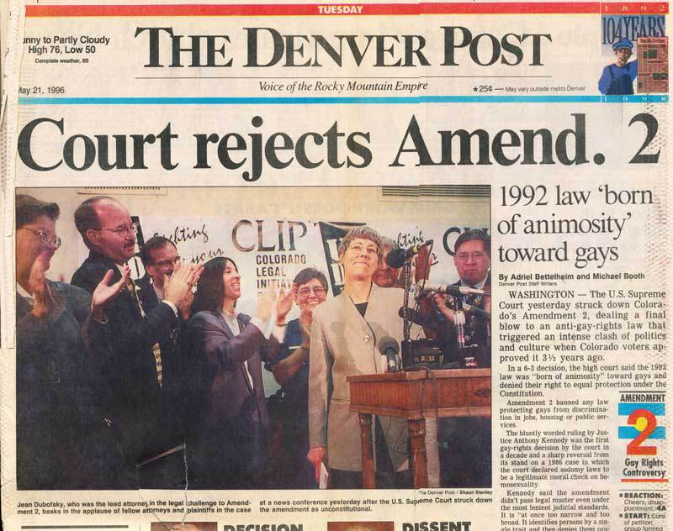
Roemer v. Evans (1996)
Roemer v. Evans (1996)
Colorado voters adopted a Constitutional amendment in 1992 whose primary purpose was to undo several municipal gay anti-discrimination ordinances
It banned all gay rights ordinances or judicial decisions in the state
Gay rights groups challenged the law and were upheld in that by the Colorado Supreme Court on the basis of violating the 14th Amendment Equal Protection Clause
It passed statewide but lost in the areas with the gay rights ordinances
Many ballot initiatives have and would in the future target the LGBT community starting with the Riggs Amendment in California to today

Slide 9
Roemer v. Evans- II
The opinion of Kennedy, J. for a 6-3 Court affirms
The law singled LBGT persons out and denied them the protections of local anti-discrimination ordinances
Law designed to target them
The law must have advanced a legitimate governmental interest, but this did not
It was not prohibiting “special rights” for gays
"If the constitutional conception of 'equal protection of the laws' means anything, it must at the very least mean that a bare desire to harm a politically unpopular group cannot constitute a legitimate governmental interest.“

Slide 10
Roemer v. Evans- III
Scalia, J. joined by Rehnquist, C.J. and Thomas, J. dissenting
Bowers allowed for laws against sodomy, so laws targeting gays were more or less approved of
Court should not override the will of voters in Colorado
He buys into the “special rights” argument of opponents of gay rights at the time
“Deterioration of sexual morality” was what Colorado voters were seeking to prevent
Homosexuality is a social harm worthy of targeting
Scalia did not say “I respectfully dissent” but only “I dissent”

Slide 11
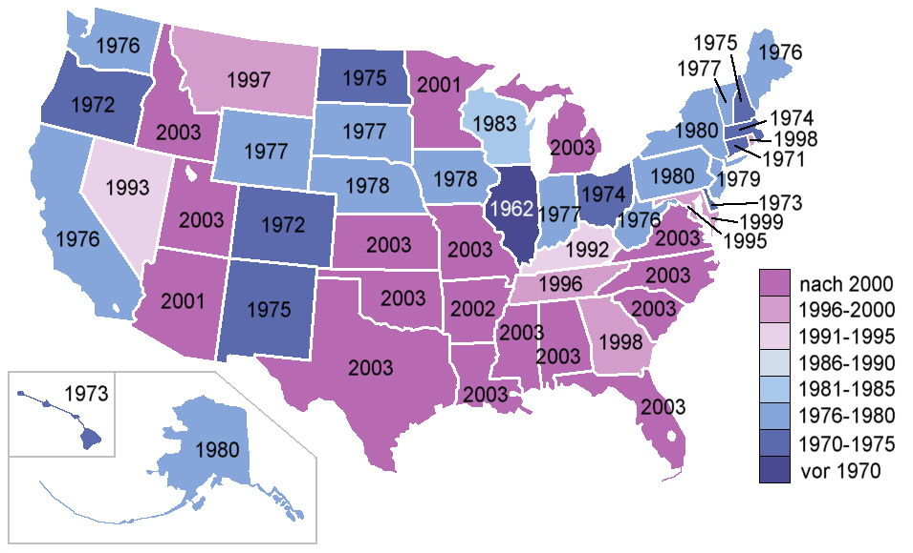
2003 State of Sodomy Laws
By 2003, only 13 states still had sodomy laws on the books
One state was Texas
Note Georgia repealed their law in 1998
Most states did not enforce these laws to any great extent

Slide 12
Lawrence v. Texas (2003)
Background
Similar to how this case was to Bowers
Police enter the apartment of Lawrence
He was engaged in anal sex with Garner
They were arrested and charged with violating the state’s sodomy law
Texas law only applied to those of the same sex
Outside groups (LAMBDA Legal) wanted this case to challenge Texas law
They ended up having to go to a trial pleading no contest to the charges after their privacy and Equal Protection claims were denied
They failed in their attempts to overturn the convictions and thus asked for cert

Slide 13
Lawrence v. Texas- II
Arguments
For Lawrence and Garnar
This law violates the right of privacy in the home and liberty rights
Bowers should be overruled
This law violates Equal Protection by singling out gays for enforcement
For Texas
Bowers still applies
There is no right to homosexual sex as a fundamental right
Rational basis applies and there are two justifications: public morality and family values
It does not target only gays

Slide 14
Lawrence v. Texas- III
Kennedy, J. for a 6-3 Court
Question for the Court is whether Lawrence is free to engage in private conduct in the exercise of their liberty under the 14th Amendment Due Process Clause
This means they have to reconsider Bowers v. Hardwick
People’s private lives
Liberty allows gays to make decisions of sexuality themselves
Only recently have laws sought to target gays, most were never enforced on the books
The Model Penal Code of 1955 took out sodomy and any penalties for private sexual relations conducted in private
Kennedy looked to a decision of the European Court of Human Rights invalidating an anti-sodomy law in Northern Ireland

Slide 15
Lawrence v. Texas- IV
More from Kennedy, J.
More on the reconsideration of Bowers
There are now only 13 states with a sodomy law on the books down from 25 before
Laws are still largely non-enforced
Two new cases since Bowers cast doubt
Casey- protection for decisions relating to marriage, contraception, procreation, family relations child rearing, and education
Romer- Striking down a law targeting gays as violating Equal Protection
These cases have eroded Bowers
Kennedy says Bowers was wrongly decided in 1986 and not correct today
It should therefore be overruled

Slide 16
Lawrence v. Texas- V
Kennedy, J. opinion
Application of the law to the case
This case involves only private, homosexual conduct within the home
The state cannot demean the existence of gays by making their private sexual conduct a crime
Due Process Clause gives them the right to engage in this without governmental interference
There is no legitimate state interest to justify this law
The 14th Amendment every generation can invoke its principals in their own search of greater freedoms
The Texas courts are reversed

Slide 17
Lawrence v. Texas- VI
O’Connor, J. concurring in judgment
She does not favor overruling Bowers
However, she does join in the overturning of the case here
She says Bowers did not hold that moral disapproval of gays was a governmental interest
That is not sufficient to justify rational basis
She finds an equal protection issue in the fact that it bans gays from engaging in one type of sexual conduct while at the same time not banning heterosexuals from the same exact conduct
She would overturn on this basis

Slide 18
Lawrence v. Texas- VII
Scalia, J. joined by Rehnquist, C.J. and Thomas, J. dissenting
He again uses the ending “I dissent”
He questions the judges that reaffirmed Roe based on stare decisis overturning Bowers v. Hardwick now
This law like many others impose a restriction on liberty
Allowed as long as due process of law followed
He notes that the Court did not apply strict scrutiny or hold gay sex as a fundamental right
Scalia would find rational basis for the law
Homosexuality immoral and unacceptable
Court signs on to “so called homosexual agenda”
They should go through the democratic process for their aims
Scalia thinks this decision may someday lead to gay marriage

Slide 19
Lawrence v. Texas- VIII
Thomas, J. dissenting
He calls the law in Texas “uncommonly silly”
He would repeal it if in the Texas General Assembly
However, he says, like Stewart, J. in Griswold that he is not a legislator and it is not his position to overturn the law
He finds no right to privacy in the Constitution

Slide 20
After Lawrence
This decision ended all remaining sodomy laws in the country
LGBT groups did achieve limited success in certain parts of the country in anti-discrimination ordinances
However, most states and the federal government remained hostile to gay rights
However, the next big fight would be on marriage after Massachusetts legalized same sex marriage in 2003
Which is where we head to next time

Slide 21
Next Lecture
Chapter 10
We will finish the part on gay rights
Can laws prohibiting same sex couples from marrying pass Constitutional scrutiny?
DOMA
California Gay Marriage Ban
Obergefell v. Hodges (2015)
Pages 438-449

