Slide 1
Lecture 35 Chapter 10
Right to Privacy VII
Right to Die, Drug Testing, New Issues

Slide 2
This Lecture
Finish Chapter 10
Dealing with
The Right to Die
Cruzan v. Missouri Department of Health Director (1990)
Drug Testing
Pages 449-460

Slide 3
What about the right to die?
Can a competent person refuse medical treatment, food, or water?
What about incompetent ones?
Can a family member or guardian make that decision?
Best interest? Whose best interest?
In Re Quinlin (N.J. 1976)
The New Jersey Supreme Court allowed the parents of a woman in a coma to remove the life support system
They were empowered to make that decision for her
Family had to show “clear and convincing evidence” that it would have been that patient’s wish not to continue life support

Slide 4
Cruzan v. Missouri Department of Health Director (1990)
Background
Cruzan was in a bad car accident
She ended up in a persistent vegetative state
She needed a feeding tube to stay alive
She could have lived thirty years like this
Her parents asked the doctors to remove the feeding tubes, which would lead her to die
The hospital refused, so they go to the courts
A friend said she would not want to live like this
They win at the trial court, but lose at the Missouri Supreme Court
They find no right to die, and wanted clear and convincing evidence

Slide 5
Cruzan v. Missouri Department of Health Director- II
Arguments
For Cruzan’s Parents
Due Process protects a patient from unwanted medical treatment
This decision should be left up to family members
Exclusion of family members from the decision with this elevated standard of proof would deny all similarly situated persons from unwanted medical treatment without serving a legitimate state end
For Missouri
This right is rooted in common law, not the Constitution
There is no right to die in the right to refuse medical treatment
The state has a strong interest in preserving life and that justifies a higher burden of proof

Slide 6
Cruzan v. Missouri Department of Health Director- III
Rehnquist, C.J. for a 5-4 Court
Individuals have a right to refuse medical treatment
But this does not extend to incompetent patients
There must be clear and convincing evidence that this was the patient’s wish
The state has interest in preserving life→ state does not have to be neutral
One cannot always guarantee that a family member will act in that person’s best interests
This decision is irreversible, so a higher standard is necessary
There was not clear and convincing evidence from a single conversation with a roommate

Slide 7
Cruzan v. Missouri Department of Health Director- IV
O’Connor, J. concurring
She suggests people plan ahead
Living wills, power of attorney
Appoint someone to act in their interests if this comes to pass
Scalia, J. concurring
Federal courts have no role here
This is a strictly state matter
Local persons know this better than the Supreme Court

Slide 8
Cruzan v. Missouri Department of Health Director- V
Brennan, J. dissenting, joined by Marshall and Blackmun, JJ.
Her right to refuse treatment is not outweighed by state interests
She is entitled to die with dignity
State should look to what that choice of the patient was
It may exclude those with improper motives
This affects many patients

Slide 9
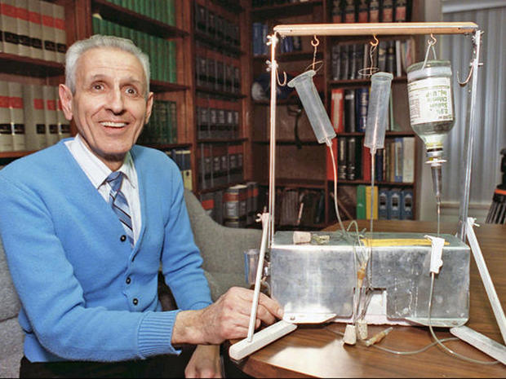
Washington v. Glucksberg (1997)
Washington v. Glucksberg (1997)
No right to doctor assisted suicide
States had a rational basis in making this illegal
Unanimous opinion
But left open the possibility of states legalizing it

Slide 10
Gonzales v. Oregon (2006)
Gonzales v. Oregon (2006)
Oregon passes an assisted suicide law
But the Bush Administration tries to overrule this under the Controlled Substances Act of 1970
The Court rules 6-3 that they did not have to power here to override states
This was more about executive deference in that Ashcroft did not have the power to issue this rule himself
He was not entitled to Chevron deference

Slide 11
Drug Testing
The Court has been mixed here
Most school drug testing upheld
But most public sector (not all) adults drug testing struck down
But this generally won’t apply when it is specifically private employment issues

Slide 12
New Issues
Doe v. Reed (2010)
Not a violation of the right to privacy to release petition ballot signatures given the interest in preserving the integrity of the electoral process
City of Ontario v. Quon (2010)
The city could search messages on public employee’s pagers
The Patriot Act provides for more governmental collection of data

Slide 13
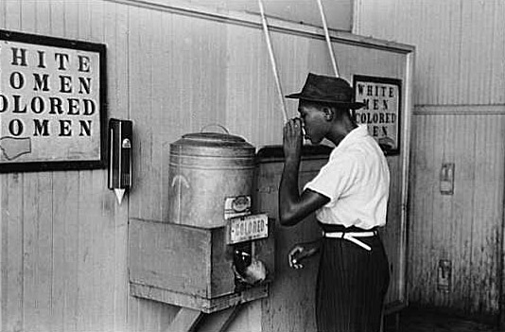
Next Lecture
Note: SKIP chapters 11 and 12
Move directly to Part IV and Chapter 13
Pages 601-608
Introduction to Civil Rights
And then
Pages 609-618
Separate but Equal
Plessy v. Ferguson (1896)
Sweatt v. Painter (1950)

