Slide 1
Lecture 40 Discrimination IV
Modern Applications of Standards

Slide 2
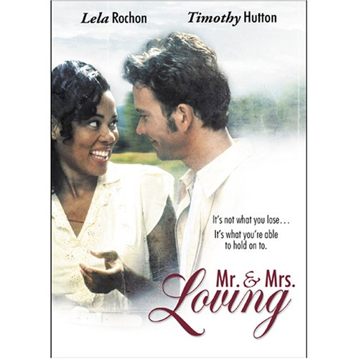
This Lecture
Pages 637-648
Application of different levels of scrutiny
Cleburne v. Cleburne Living Center (1985)
Interracial Marriage
Loving v. Virginia (1967)

Slide 3
Classifications Framework
Questions to ask on scrutiny levels
Class→ suspect, quasi-suspect, all others
Facial vs. facial neutrality
Discriminatory impact (effect)→ bi-variate
Discriminatory intent→ multi-variate
Gender claims seem to always go to intermediate scrutiny
Because of differences between men and women
Think back to the Caroline Products Footnote
Immutable characteristics
Insular minorities
Elected officials may not be trusted to protect their rights

Slide 4
New York City Transit Authority v. Beazer (1979)
New York City Transit Authority v. Beazer (1979)
The Transit Authority would not hire those that used narcotics
This included methadone
The plaintiff challenged this law
This was subject to rational basis review→ methadone vs. non-methadone users
Transit Authority said it was to maintain a capable and reliable workforce→ safety
Safety, health and welfare as the strongest state arguments
They generally do not question the motive
There still needs to be a fit between the policy and the reason for it
It can also be under or over inclusive
Plaintiffs here argued that it also targeted minorities
However, a 6-3 Court ruled it was for public safety

Slide 5
Cleburne v. Cleburne Living Center (1985)
Background
Plaintiff purchased a building with the intent to operate a group home for mentally retarded men and women
She applies for a special permit for those “feeble minded”
She was denied by the city and filed an appeal saying that the zoning ordinance discriminated against the mentally retarded and violated the Equal Protection Clause
The district court upholds the decision based on rational basis, but the COA reverses
They say that the mentally retarded should be subject to intermediate scrutiny
Citing mistreatment and prejudice against them, immutable characteristic and lacking power
White finds that they are not a suspect class and applies rational basis

Slide 6
Cleburne v. Cleburne Living Center- II
Arguments
For the City of Cleburne
The city has a legitimate interest in the location of this home
It is across from a junior high school and in a flood plain
For the Cleburne Living Center
This violates equal protection under any standard
This is based on prejudice against the mentally retarded as many other uses are permitted

Slide 7
Cleburne v. Cleburne Living Center- III
White for a sort of unanimous Court (on this part)
Home loses on quasi-suspect class argument, so it goes to rational basis
The city does not require the same permit except for insane, feeble minded, alcoholics, drug addicts→ other multiple dwelling facilities accepted
The city loses under rational bases
This home poses no special threat to the city’s legitimate interests
Attitudes against the facility do not cut it
The school they fear might have students harassing residents contains several students who are mentally retarded and the 500 year flood plain argument is silly (my word)
If not for residents being mentally retarded the home would meet all other requirements
There was no proper fit between the zoning laws and legitimate objectives

Slide 8
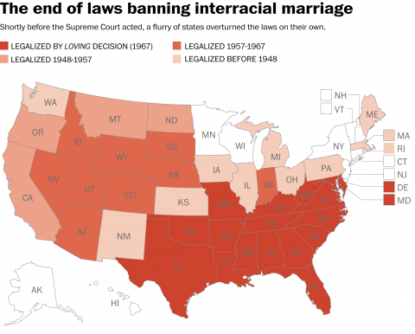
Strict Scrutiny- Burdening Minorities
Rational basis is deferential to the government, but not strict scrutiny
When dealing with issues of racial minorities
African-Americans get rigid protections of strict scrutiny
Most rational basis challenges are denied
Most challenges based on disadvantaging racial minorities are denied
What about marriage between those of different races?

Slide 9
Loving v. Virginia (1967)
Background
At the time, 16 states outlawed interracial marriage (several only recently repealed those laws as well→ public opinion opposed strongly)
The plaintiffs married in DC and were white and black
They moved back to Virginia and were charged with violating state law
The judge said God prohibited interracial marriage by placing races on different continents
They were given a suspended sentence on the condition that they not return to Virginia for 25 years
The ACLU and civil rights groups take up the case to challenge the law on the basis of the Equal Protection Clause
They lose at the Virginia Supreme Court and appeal
Note: This was not at all a facially neutral law

Slide 10
Loving v. Virginia- II
Arguments
For the Lovings
It is based from slavery and racist because it based on racial inferiority
Brown prevents laws that criminalize based on race
The law denies the human right to choosing one’s marital partner
For Virginia
At the time of the 14th Amendment most states banned interracial marriage
It was never the intent of the 14th Amendment to reverse this
Persons of both races are equally punished for violating this law (think O’Connor in Lawrence v. Texas?)
This should be up to states to decide and this is part of state police powers

Slide 11
Loving v. Virginia- III
Warren, C.J. for an unanimous Court
Laws banning interracial marriage struck down by the 14th Amendment
State marriage regulation authority not unlimited
These laws have no rational purpose
Purpose of the 14th Amendment was to eliminate all racial discrimination in states
Marriage is a “basic right of man”
Application of strict scrutiny→ Hirabayashi (1943) and Korematsu (1944)
It is fundamental to human existence and survival
This should not be subject to racial discrimination in this choice
This was based on white supremacy
Overrules Pace v. Alabama (1883)

Slide 12
Washington v. Davis (1976)
Washington v. Davis (1976)
Laws written facially neutral but have discriminatory effect
Challenge to a DC police application that had a written section that four times as many blacks as whites failed
Court by White, J. (7-2) said that one needed to prove discriminatory intent
However, one can still use federal civil rights law instead of the 14th Amendment
See also City of Mobile v. Bolden (1980)

Slide 13
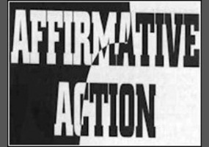
Next Lecture
Pages 648-660
Affirmative Action I
Regents of the University of California v. Bakke (1978)
Application of Strict Scrutiny

