Slide 1
Lecture 42 Economic Substantive Due Process
Part 1: Development: Initial Interpretations

Slide 2
This Chapter
Organization of the Chapter
Development
The Roller Coaster
The Heyday
New Deal and Decline
Contemporary

Slide 3
Cases this Chapter
The Slaughterhouse Cases (1873)
Munn v. Illinois (1877)
Allgeyer v. Louisiana (1897)
Lochner v. New York (1905
Muller v. Oregon (1908)
Adkins v. Children’s Hospital (1923)
Nebbia v. New York (1934)
West Coast Hotel v. Parrish (1937)
Williamson v. Lee Optical Company (1955)
BMW of North America v. Gore (1996)
Caperton v. A.T. Massey Coal Company (2009)

Slide 4
The Lecture
We will cover the first part on development
Interpretation
Pages 625-633

Slide 5
Economic Substantive Due Process
What is it?
The Constitution is violated when the government unreasonably or arbitrarily denies rights that are inherent to freedom of an individual
Unfairly depriving a person of life, liberty or property
Some charged this was judicial activism
To rule against regulations and in favor of business
This ties in with other ways statutes were struck down
Delegation of powers
Commerce Clause
Taxing and Spending Power
Tenth Amendment

Slide 6
Development
Before the Civil War
People were entitled to orderly and fair proceedings
Taney mentions property rights in Dred Scott
Wynehamer v. People (1856)
Strikes down a prohibition law
The 14th Amendment then comes into play
Language of the 5th Amendment is added against the states
Was this meant to protect the rights of African Americans or everyone?

Slide 7
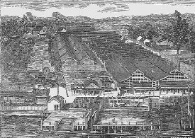
The Slaughterhouse Cases (1873)
The Slaughterhouse Cases (1873)
Background
Industrialization also brought pollution
The State of Louisiana said that butchers dumping animal parts and garbage in the Mississippi River were polluting it
To remedy it (or to create a monopoly), the legislature created a central slaughterhouse in New Orleans to receive and slaughter all city livestock for 25 years
The butchers were forced to use this company and facilities to slaughter and they had to pay high prices for the privilege→ they sue
Question
Did the creation of this monopoly violate either the 13th or 14th Amendments?

Slide 8
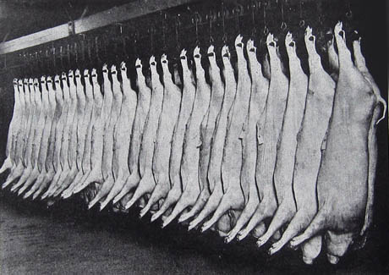
The Slaughterhouse Cases- II
Arguments
For the Butchers (it violates the constitution)
The rights of the 13th and 14th Amendments apply to all
Americans have the right to engage in any useful business or occupation and a right to the income that flows from it
Forcing the butchers to use this one provision violates the 13th Amendment
This violates the 14th Amendment by denying the butchers their property without due process of law by depriving them of their right to pursue this trade
No condition of public health necessities this monopoly

Slide 9
The Slaughterhouse Cases- III
Arguments
For the State of Louisiana (uphold the law)
The law does not deny the butchers a profession
It only requires they do their slaughtering in one location
The first section of the 14th Amendment was meant only for blacks
The police power of a state is wide and extends to all in its boundaries
The police power is being used to eliminate unhealthy or infectious articles or activities

Slide 10
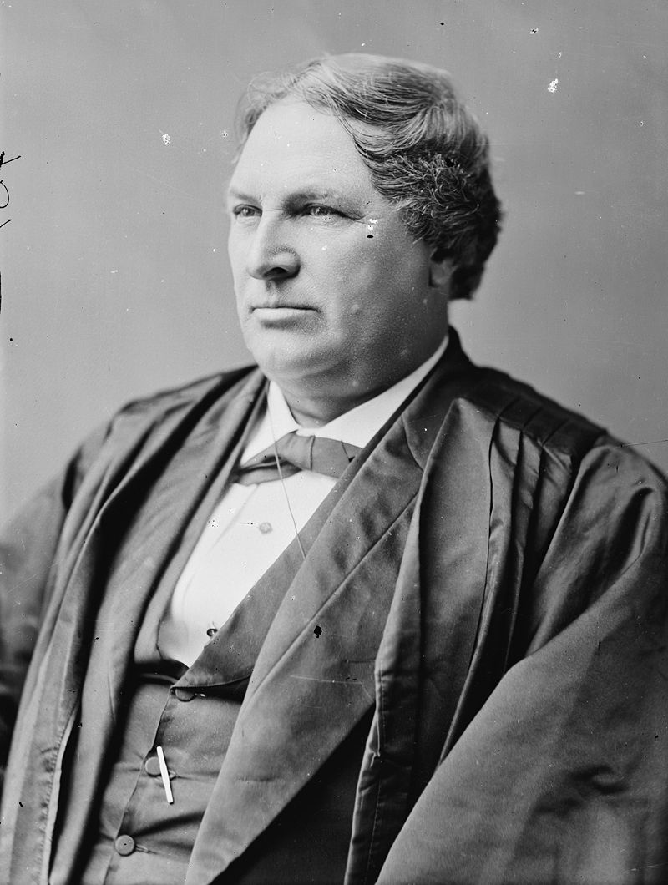
The Slaughterhouse Cases- IV
Justice Miller writes the decision for a 5-4 Court
Only the 15th Amendment mentions blacks by name
But noted the purpose of the other amendments were to invalidate laws against blacks
But he did not preclude any claims by others
The Due Process part of the 14th Amendment is identical to the 5th Amendment
They then focus on the privileges and immunity clause
It was meant to forbid states from withholding privileges and immunities belonging to U.S. citizenship, not state citizenship→ a narrow ruling
Those privileges and immunities apply only to rights found in the Constitution
The butchers were not deprived of their rights because they could still engage in their profession at the Crescent City Slaughterhouse
He did not want the Court to be able to veto state laws

Slide 11
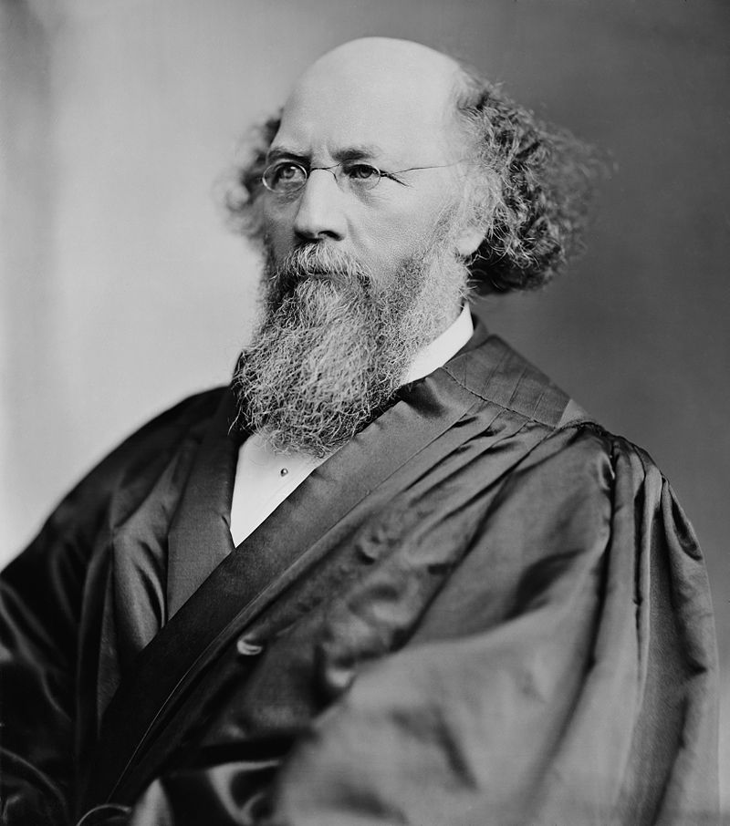
The Slaughterhouse Cases- V
Justice Field, dissenting
Joined by Chase, Swayne and Bradley
He believes these provisions apply to all citizens
He finds the majority makes the 14th Amendment rather meaningless
This should be applied to state laws as well
This would protect property interests against state legislative which violates it

Slide 12
The Slaughterhouse Cases- VI
Bradley, J. dissenting
He takes an extremely expansive view of the 14th Amendment
This would include their lawful choice of employment
Blacks may have been the intent for this amendment but the languages is clear that the protections belong to everyone
He sees this as potentially encroaching on state’s rights
Louisiana amends its constitution to bar these monopolies
The Slaughterhouse sued on the Contract Clause
The Court rules against them in 1884 based on its Contract Clause precedent

Slide 13
Next Lecture
The Courts open a window to Substantive Due Process
Pages 633-654
We may break this in two lectures
The most important case is Lochner

