Slide 1
Lecture 46 Economic Substantive Due Process
Part 5: The New Deal and Decline

Slide 2
This Lecture
We move to the New Deal cases and the decline of Substantive Due Process
Pages 658-669

Slide 3
Nebbia v. New York (1934)
Nebbia v. New York (1934)
Background
New York creates the Milk Control Board in 1933, which could set prices
They set the price at 9 cents a quart
Nebbia sells two quarts of milk and a five cent loaf of bread for 18 cents
He is convicted and fined $5 for violations, but paid the fine under protest
He said these controls interfered with his ability to do business
New York justified the law by saying farmers needed to get a good return on their product if the country wants a good supply of milk
The dairy industry is very important to New York

Slide 4
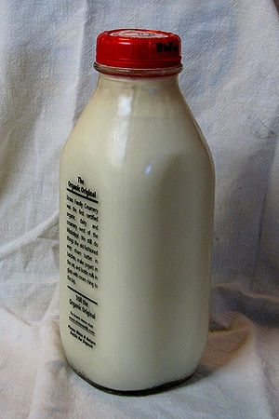
Nebbia v. New York- II
Question
Did the regulation violate the Due Process Clause of the Fourteenth Amendment?
Arguments
For Nebbia (strike down the law)
Laws in other states regarding price fixing have been struck down as violating the due process clause of the 14th Amendment
This law discriminates against him because it does not also apply to home delivery
The nation’s emergency does not suspend the constitution
This violates the liberties of the buyer and seller to reach an agreement over a price

Slide 5
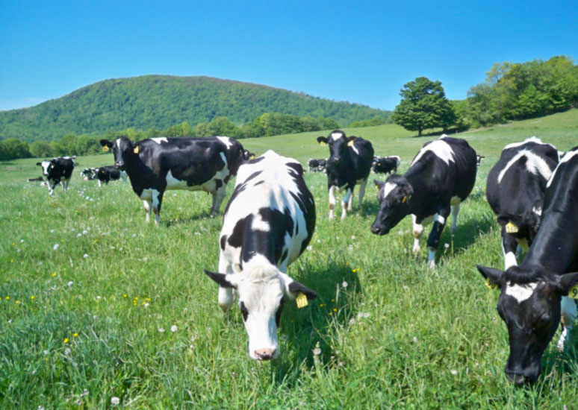
Nebbia v. New York- III
Arguments
For New York (uphold the law)
The necessity for any exercise of police powers are vested in the legislature
Milk’s importance means it can be regulated as a public utility
Fixing prices is a form of utility regulation
There is a clear relationship between control of milk prices and the public interest

Slide 6
Nebbia v. New York- IV
Justice Roberts writes for a 5-4 Court
The liberals were victorious here
As a general rule, the use of property and making of contracts→ not public concern
However, this is not absolute
It may be regulated for the common interest
New York built a substantial record as to the need for the milk regulation
There was a problem of surplus milk and price cutting by stores so that farmers were making less than the cost of production of the milk
He rejects milk being a public utility but also that regulations only apply to a utility
This case is more analogous to Munn v. Illinois
If the laws have a reasonable relationship to a proper legislative purpose and is not arbitrary or discriminatory, the requirements of due process are satisfied then the Court will not disturb those laws
A big nod to judicial deference

Slide 7
Nebbia v. New York- V
McReynolds, J. dissenting
Joined by Butler, Van Devanter and Sutherland
He argues that this is not regulation, but management, control and dictation
It deprives him of his fundamental right to control his decisions
This would allow the government to convert nearly every sector into a public utility
To allow this would be to put an end to liberty under the Constitution
This would take away the ability of all New Yorkers to buy milk on the open market
Some might need to the milk to be cheaper and the grocer would oblige

Slide 8
Morehead v. New York ex rel. Tipaldo (1936)
Morehead v. New York ex rel. Tipaldo (1936)
This case involved a New York minimum wage law that prevented women from being paid an unreasonable and oppressive wage
Less then the reasonable value of services and below the minimum cost of living to sustain their health
Tipaldo was found guilty of not paying these wages
Women’s groups sided with Tipaldo on gender equality grounds
Roberts changes sides from Nebbia
The Court decided this case was closer to Adkins than Nebbia so it ruled against New York’s law
Some say this was one of the decisions where FDR finally had it with the Court

Slide 9
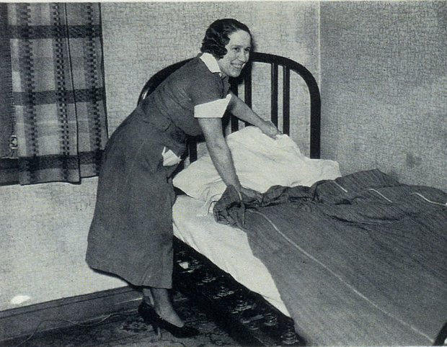
West Coast Hotel v. Parrish (1937)
West Coast Hotel v. Parrish (1937)
Background
The person here had been a maid at a hotel
When she was let go, she asked for back pay equal to what she would have received had the company complied with Washington State’s minimum wage
She refused to settle and won at the Washington Supreme Court level
The hotel appealed
Question
Did the minimum wage law violate the liberty of contract as construed under the Fifth Amendment as applied by the Fourteenth Amendment?

Slide 10
West Coast Hotel v. Parrish- II
Arguments
For West Coast Hotel (strike down law)
Adkins struck down a similar regulation under the 5th Amendment, and the claims are more or less identical
Tipaldo also overturned a similar law applied to women
These cases should control
For Parrish (uphold the law- pay her the $$$)
The Washington legislature is who decides what the public welfare is and they decided it would be served by a minimum wage
Adkins does not apply because state’s police powers are broader than the federal
There should be a presumption of constitutionality

Slide 11
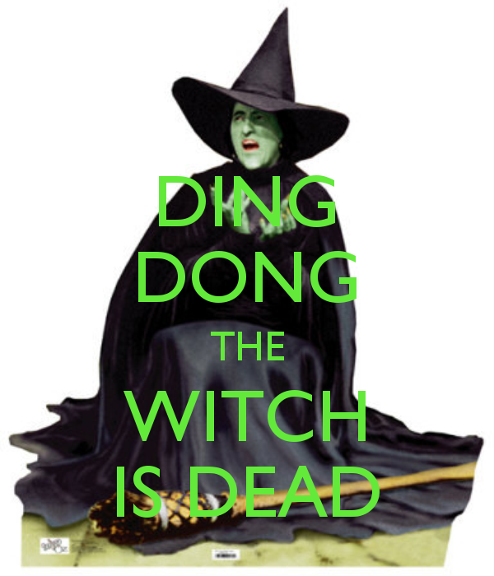
West Coast Hotel v. Parrish- III
Chief Justice Hughes, writing for a 5-4 Court
Adkins is explicitly overruled
Roberts switches his vote again
This was one of the White Monday cases
Liberty is subject to regulation for health, safety, morals and general welfare
There is not absolute freedom to contract
The statute does not compel anyone to do anything, just not pay wages below that amount
This was to ensure minimum standards of living
Employers and employees were not completely free in negotiations
The Great Depression helps to justify this law
They continue with Muller on the role of women
The effect is to make this more of a rational basis test

Slide 12
West Coast Hotel v. Parrish- IV
Sutherland, J. dissenting
Joined by McReynolds, Butler and Van Devanter
The Court failed to follow precedent
He argues against judicial deference
The Constitution does not change with the ebb and flow of events
He rejects the living constitution doctrine

Slide 13
Williamson v. Lee Optical Company (1955)
Williamson v. Lee Optical Company (1955)
Background
Oklahoma had a law that made it illegal for anyone other than an ophthalmologist or optometrist to fit, adjust, or apply lenses framers or any other things to the face
This company challenged it is as having no reasonable reason to public health
It violated its right to perform its craft
Question
Did the Oklahoma law violate the Due Process Clause of the Fourteenth Amendment?

Slide 14
Williamson v. Lee Optical Company- II
Arguments
For Oklahoma (uphold the law)
This is a matter of public health→ provide citizens with the best vision care possible
The Court should defer to the Oklahoma General Assembly as to public policy here
There should be a presumption of constitutionality
For Lee Optical (strike down the law)
They are denying the rights of opticians to perform their jobs
This violates their due process rights
This law is not a public health measure

Slide 15
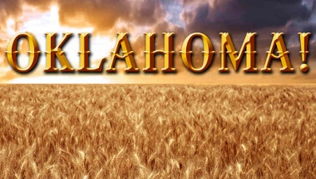
Williamson v. Lee Optical Company- III
Justice Douglas writes for a unanimous Court
He acknowledges this may be a wasteful requirement
The Court applied a rational basis review of the statute
The Court must defer to the judgment of the legislature
It is not up to the Courts to determine whether this was wasteful or needless
“The day is gone when this Court uses the Due Process Clause of the Fourteenth Amendment to strike down state laws, regulatory of business and industrial conditions, because they may be unwise, improvident, or out of harmony with a particular school of thought."

Slide 16
Next lecture
We will finish up Chapter 10
Pages 689-682

