Slide 1
Lecture 47 Voting and Representation I
Elections and the Court

Slide 2
This lecture
We will start Chapter 14
This is the last chapter
Pages 717-723
Elections and the Court
Bush v. Gore (2000)

Slide 3
Bush v. Gore (2000)
Bush v. Gore (2000)
Background
The 2000 Presidential election came down to the State of Florida
Early in the evening, the state was called for Gore based on exit polls
However, as results came in, the call was withdrawn
After 2 AM, the state was called for Bush
However, that call was based on erroneous data from Volusia County
Late returns from South Florida made the race too close to call
Gore withdraws his concession minutes before he would concede
Bush won by 1784 votes out of more than 6 million in the initial count
But that number dropped even more

Slide 4
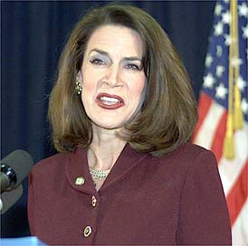
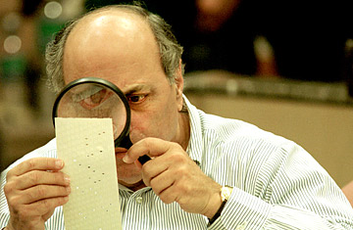
Bush v. Gore- II
More background
Florida law required a machine recount if the margin was below a half a percent
The machine recount made it even closer
Issues in the recount
Palm Beach butterfly ballot
Hanging chad- what standard to use?
Brooks Brothers riot in Miami
The voter purge- disproportionate to African Americans
Katherine Harris wanted to cut it off and certify for Bush
Florida election law was backwards
One had to ask for recounts county by county- cherry-picking allegation
Different counties had different machines

Slide 5
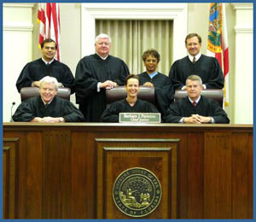
Bush v. Gore- III
Other issues
The Florida Supreme Court was of Democratic appointees
But the Governor was named Jeb Bush
The Legislature was heavily Republican
The U.S. Supreme Court was largely Republican appointees
So, it was of advantage for Democrats to keep the case in Florida courts, but for Republicans to get the case into federal court
Dates to take into account
November 18- Florida law date to certify
December 12- Federal safe harbor (3 U.S.C. §5)
December 18- Date for electors to cast ballots

Slide 6
Bush v. Gore- IV
Initial cases
The Florida Supreme Court extends the certification deadline to November 26
However, Palm Beach wasn’t finished and Miami-Dade quit counting
Then in Palm Beach Canvassing Board v. Harris, (Fla. 2000), the Florida Supreme Court rules Harris should not have certified
But in Bush v. Palm Beach Canvassing Board (2000), the U.S. Supreme Court send the case back to the Florida Supreme Court for clarification
Then in response in Gore v. Harris, (Fla. 2000), the Florida Supreme Court orders a full statewide recount of all under votes
But they failed to set one standard for their counting
To the surprise of many, the Supreme Court issues a 5-4 ruling granting a stay of the recount
There were a lot more cases in the state court level than I can go over

Slide 7
Bush v. Gore- V
Questions
Did the Florida Supreme Court violate Article II, Section 1, Clause 2 by making new election law?
Did the lack of a standard for the manual recount violate the Equal Protection and Due Process clauses?
Arguments
For Bush
Florida signed up for the safe harbor provision
Therefore the Florida Supreme Court changed state law rather than interpreted it
The State Legislature is the final arbiter of how electoral votes are distributed
The Florida House Speaker had the House vote to award the electoral votes to Bush
But in choosing the safe harbor provision, they said contests should end by December 12
The lack of a clear standard in the recount violates equal protection

Slide 8
Bush v. Gore- VI
Arguments
For Gore
Safe harbor is only an option
The Florida Court merely interpreted state law
The decision is consistent with Equal Protection
All hand recounts are subject to supervision by the county canvassing board and review by the Florida judicial branch
The overarching goal is to have every vote counted

Slide 9
Bush v. Gore- VII
Per curiam opinion
We don’t know who primarily wrote it, but many have speculated it was O’Connor
The state legislature determines the counting of electoral votes in a state under the Elections Clause, and they never formally gave that power up
Equal protection- one cannot weigh one vote more than another by arbitrary or disparate treatment
The Florida Supreme Court failed to set out a standard for non-arbitrary treatment of votes, and intent of the voter doesn’t satisfy this
Uniform rules were necessary on a statewide basis
Failure to look at all ballots
Failure to look at over votes

Slide 10
Bush v. Gore- VIII
More on the Per Curiam opinion
The Florida Supreme Court needed to set out uniform standards for each of the counties to follow
However, since the Court said that Florida had opted into the safe harbor provision, they did not have time to do the proper recount, the case was over
The opinion was delivered at 10PM the night of the deadline
So the recount ends and the certification stands- Bush wins
The Court ruled this opinion was unique only to this case
The Equal Protection vote was 7-2
The shutting down of the recount vote was 5-4

Slide 11
Bush v. Gore- IX
The Concurrence
Rehnquist, Scalia and Thomas
They thought Article II Elections Clause required the Florida Supreme Court to give deference to the manner the state legislature proscribed for the method of election of electors
They felt the Florida Supreme Court had littler role here
The Stevens dissent
Joined by Ginsburg and Breyer
The Florida Court had authority to decide these issues
The Court should have given deference to Florida Courts on Florida law
They were substituting their interpretations for those of Florida’s judiciary
The Equal Protection issue can be alleviated by the Florida process that includes a judge

Slide 12
Bush v. Gore- X
The Souter dissent
Joined by Breyer in whole and Ginsburg and Stevens in part
The Court should have never reviewed the Florida Supreme Court decisions
Defer to Florida Supreme Court on interpretation of Florida law
Should not have issued the stay and stopped the recount
It would have been done by now
Should have been left to political process
Safe harbor determinations are made by Congress, not the courts
The proper place for disputed election is the Congress
Florida really has until December 18 to count the votes, not December 12
The Equal Protection argument ignores how there is a variety of types of voting machines within the state with different levels of effectiveness of ascertaining votes cast
There is already a disparity

Slide 13
Bush v. Gore- XI
The Breyer dissent
Joined by Stevens and Ginsburg in whole and Souter in part
The Court was wrong to grant cert, stay the recount and end the process
The Florida court could wrap everything up by December 18
There is no record of evidence that it could not have
He was very critical of the Court taking up this case and deciding it the way they did
Check on the Court’s own exercise of power
Judicial self-restraint
“The most important thing we do is not doing”- quoting Stone from Butler
The case did not change public opinion so much on the Court however

Slide 14
Bush v. Gore- XII
The Ginsburg dissent
Joined by Stevens in whole, and Souter and Breyer in part
Deference to the Florida Supreme Court on Florida law
Calls out the majority for hypocrisy
The Florida courts have acted quickly and can again to meet the deadline
After this:
Gore concedes
Bush wins 271-267*
Bush is reelected in 2004

Slide 15
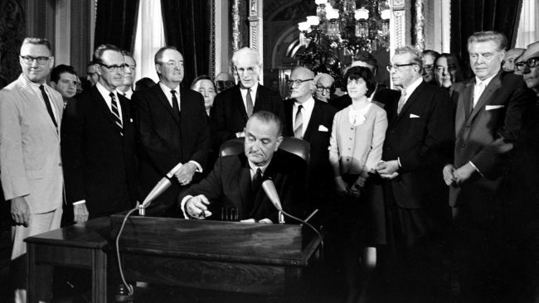
Next Lecture
Pages 723-736
Voting Rights
South Carolina v. Katzenbach (1966)
Shelby County v. Holder (2013)

