Slide 1
Lecture 5 Chapter 3
Incorporation of the Bill of Rights

Slide 2
Major Cases in this Chapter
Barron v. Baltimore (1833)
Hurtado v. California (1884)
Palko v. Connecticut (1937)
Duncan v. Louisiana (1968)

Slide 3
This Lecture…
This lecture traces the history of incorporation
Do states have to abide by the Bill of Rights?
The always have not
After all most laws are state laws, not federal ones
Though many states had their own constitutional protections (but others did not)
Effect of the 14th Amendment
This seems to have changed things
Palko
The Modern Law

Slide 4
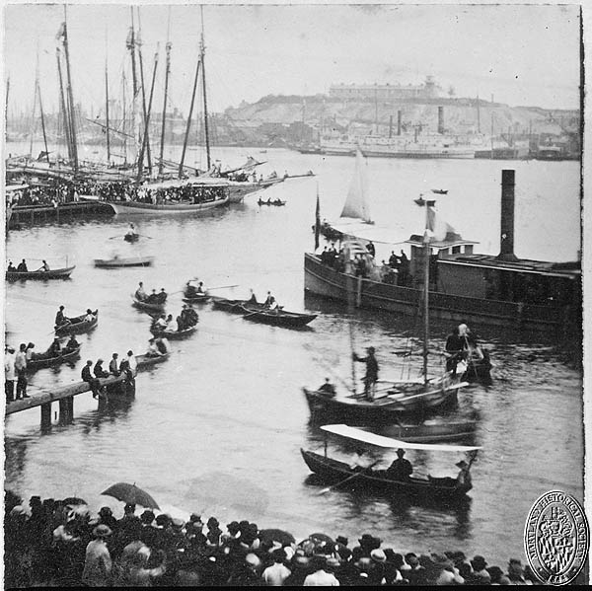
Barron v. Baltimore (1833)
Background
The City of Baltimore made changes that led to the plaintiff seeing his deep water wharf fill with sand and depris
He wanted the area dredged, but the city ignored his request
He sued for damages based on the city’s changes based on the Takings Clause

Slide 5
Barron v. Baltimore- II
Arguments
For Barron
The city engaged in a Taking, violating the Fifth Amendment
The 5th Amendment was meant to apply against states and the federal government
He is owed money $$$ from the City since their actions caused economic loss
For the government of the City of Baltimore
Roger Taney didn’t get to present an argument

Slide 6
Barron v. Baltimore- III
Unanimous opinion of the Court (6-0) by Chief Justice Marshall
Bill of Rights apply only to federal government
States have their own constitutions
The framers would have expressly said the rest of the Constitution applied to the states if they wanted it to
One thing to remember is that most laws are state laws, not federal ones

Slide 7
The 14th Amendment
Language of the 14th Amendment:
Section 1.
All persons born or naturalized in the United States, and subject to the jurisdiction thereof, are citizens of the United States and of the state wherein they reside. No state shall make or enforce any law which shall abridge the privileges or immunities of citizens of the United States; nor shall any state deprive any person of life, liberty, or property, without due process of law; nor deny to any person within its jurisdiction the equal protection of the laws.
Did this make the Bill of Rights applicable to states?
The Slaughterhouse Cases (1873) say no
The 5-4 decision narrowly interprets the Privileges and Immunities Clause
It was meant to forbid states from withholding privileges and immunities belonging to U.S. citizenship, not state citizenship→ a narrow ruling
Those privileges and immunities apply only to rights found in the Constitution

Slide 8
Hurtado v. California (1884)
Background
Defendant kills a person, and is charge via a chagrining information rather than a grand jury as is the case in the 5th Amendment
Arguments
For Hurtado
The 14th Amendment incorporates the grand jury right to the states
For California (not Utah)
Barron v. Baltimore (1833) still applies

Slide 9
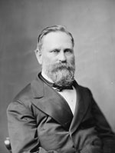
Hurtado v. California- II
A 7-1 decision by Justice Matthews
No incorporation→ if the 14th Amendment wanted to incorporate this right against the states, it would have stated it expressly
A charging information is still due process
This did not preclude incorporation in the opinion
The grand jury requirement was never incorporated

Slide 10
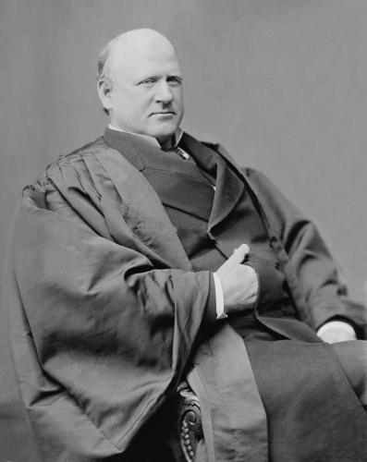
Hurtado v. California- III
Harlan, J. dissenting
Known as the “Great dissenter”
Distinguishes the fact that this is a capital case

Slide 11
Subsequent cases
Chicago, Burlington & Quincy Railroad v. Chicago (1897)
Harlan writes for the Court that the states must abide by the Takings Clause of the 14th Amendment
Maxwell v. Dow (1900)
The Court refuses to extend the trial by jury right to the states
Twining v. New Jersey (1908)
An 8-1 Court refuses to extend the protection against self-incrimination to the states (Harlan dissenting)
But it does not close the door on incorporation→ selective incorporation
Gitlow v. New York (1925)
Incorporates First Amendment

Slide 12
Palko v. Connecticut (1937)
Background
Involved the double jeopardy clause of the 5th Amendment
Arguments
For Palko
Double jeopardy is a fundamental right
Protected by the 14th Amendment
For Connecticut
Not a fundamental right or protected by the 14th Amendment
Connecticut law applies, not the 5th Amendment

Slide 13
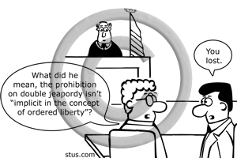
Palko v. Connecticut- II
Justice Cardozo for an 8-1 Court (Butler, J. dissenting)
Rejects the broad interpretation of the 14th Amendment
Does not violate “fundamental principles of liberty and justice which lie at the base of all our civil and political institutions”
Palko loses and gets the chair
Further selective incorporation

Slide 14
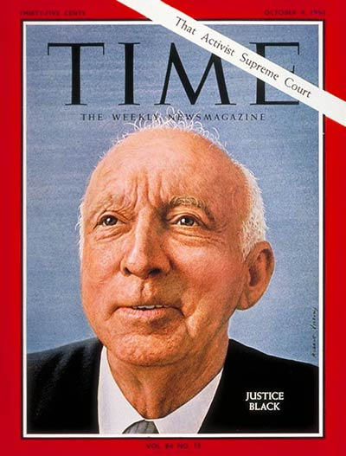
After Palko
Further selective incorporation by the Court
Adamson v. California (1947)- Court refuses to incorporate self-incrimination
However, other voices on the Court would gain sway
Black and Douglas (plus Murphy)
And later Warren, Brennan, Clark
Note: Court composition has consequences!

Slide 15
Duncan v. Louisiana (1968)
Background
A black man in Louisiana is charged in what some say as a racially motivated arrest
He was denied a trial by jury under Louisiana law and convicted
Arguments
For Duncan
Right to a trial by jury is a fundamental right and should be incorporated
For the State of Louisiana
Offenses of less than six months in jail are petty and not subject to a jury trial
Jury trial is not a fundamental right

Slide 16
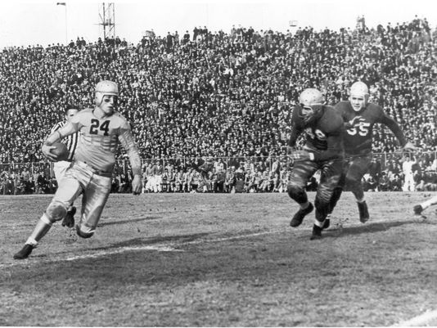
Duncan v. Louisiana- II
Justice White writes for a 7-2 majority
Right to trial by jury fundamental to the American scheme of justice
White traces this back to England
Maxwell v. Dow and Palko v. Connecticut have been repudiated by the Court
The Court leaves open the difference between petty and serious crimes

Slide 17
Duncan v. Louisiana- III
Black, J. concurring
Joined by Douglas, J.
Would extend the entire Bill of Rights to the states
He is glad to support selective adoption however
Note the Court still does selective adoption
Fortas, J. concurring
Would not extend to unanimous juries
Would leave some state variations

Slide 18
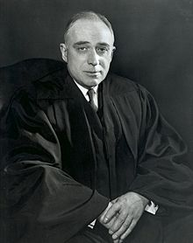
Duncan v. Louisiana- IV
Harlan, J. dissenting
Joined by Stewart, J.
Harlan, unlike his grandfather, long opposed most of incorporation
He criticizes the majority not ruling on what is included

Slide 19
More Rights
See Table 3-1 (page 79)
2nd Amendment

Slide 20
Next lecture
We move into Civil Liberties
Quickly read pages 89-94 as an overview of the topic
Spoiler: Ideology of justices matter!
Then move to the Religion Clauses
Read pages 95-105 (up to Sherbert-Yoder Test)
Note: Please keep up
We need to get through each section quickly
Religion clauses go to Page 190
Given the course time frame we go through them very quickly

