Slide 1
Lecture 50 Voting and Representation IV
Campaign Finance Law

Slide 2
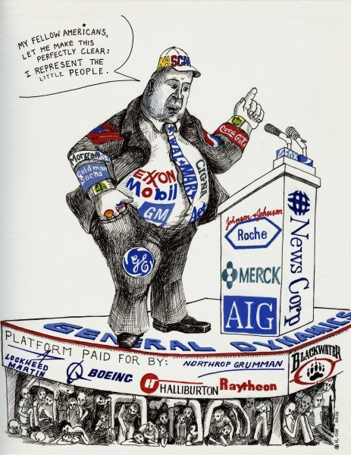
This lecture
Pages 741-755
Campaign Finance
Citizens United v. Federal Election Commission (2010)
McCutcheon v. Federal Election Commission (2014)

Slide 3
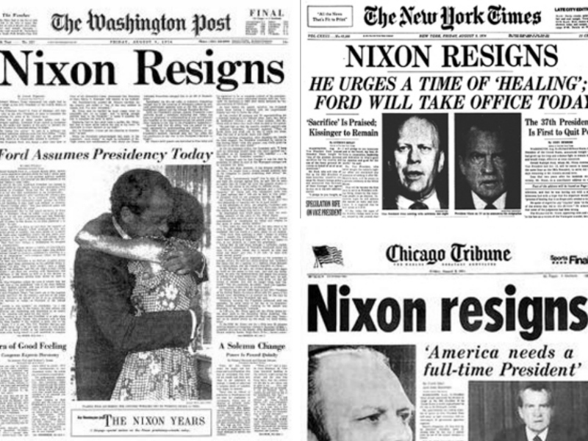
Watergate
In the wake of the Watergate Scandal, Congress enacts new rules on campaign finance
Limits on how much people could contribute
Disclosure requirements
Limits on independent expenditures

Slide 4
Buckley v. Valeo (1976)
Buckley v. Valeo (1976)
Case stands for the proposition that campaign spending is speech
Two main parts
Limits on contributions was upheld to promote electoral integrity and fight corruption
Designed to stop “quid pro quo” corruption
Upheld the matching system of government funding
Upheld disclosure requirements
But several things were not upheld
Limits on independent expenditures
Limits on use of personal funds
Limits on total campaign spending

Slide 5
Austin v. Michigan Chamber of Commerce (1990)
Austin v. Michigan Chamber of Commerce (1990)
Upheld a restriction on using corporate funds for independent expenditures for the purpose of expressly advocating for the defeat or election of a candidate

Slide 6
McConnell v. Federal Election Commission (2003)
McConnell v. Federal Election Commission (2003)
Challenge to BCRA (also know as McCain-Feingold)
Ban on national parties raising soft money
Prevented unions and corporations from using funds for electioneering
Raised contribution limits
The Court (5-4) upholds this law
However, O’Connor is replaced in 2006 by the more conservative Alito

Slide 7
Subsequent cases
Randall v. Sorrell (2006)
Strikes down Vermont’s very low contribution limits as restricting speech
Davis v. Federal Election Commission (2008)
Strikes down the Millionaire’s amendment in the BCRA

Slide 8
Citizens United v. Federal Election Commission (2010)
Background
Citizens United is a non profit that gets some money from for profit corporations
They make a movie critical of Sen. Hillary Clinton in 2008
The movie would be available on Video on Demand and cable
They feared they might violate the law so they sued the FEC
They felt the ban on corporations and unions using funds for electioneering was unconstitutional here
Also thought the disclosure and reporting requirements as applied to them unconstitutional

Slide 9
Citizens United v. Federal Election Commission- II
Arguments
For Citizens United
Government cannot suppress speech except to prevent corruption or its appearance
This is not express advocacy
Austin v. Michigan State Chamber of Commerce (1990) should be overruled
For the FEC
Congress can restrict corporations from using funds for express advocacy or equivalent
This is the functional equivalent of express advocacy here
There is no exceptions for films or video on demand

Slide 10
Citizens United v. Federal Election Commission- III
Kennedy, J. for a 5-4 Court
They overrule Austin and these challenged restrictions
They find that this law contains an outright ban on speech during certain times
Upholding this would silence speech and have a chilling effect
Therefore this law is subject to strict scrutiny
They extend speech protections to corporations→ “Corporations are people”?
Interferes with the “open marketplace” of ideas
They also overrule part of McConnell
However, the disclosure requirements are constitutional

Slide 11
Citizens United v. Federal Election Commission- IV
Scalia, J. concurring, joined by Alito, and in part by Thomas, J.
First Amendment applies to speech, not speakers
It doesn’t matter how persons have organized themselves
The nature of speech doesn’t change if it is funded by a corporation
To do so would muzzle speech
We should celebrate this speech
Thomas, J. concurring in part and dissenting in part
He does not think the Court went far enough
He would strike down the disclosure, disclaimer and reporting requirements as well

Slide 12
Citizens United v. Federal Election Commission- V
Stevens, J. joined by Ginsburg, Breyer, and Sotomayor, J concurring in part and dissenting in part
The issue is how persons may finance their electioneering
This law does not ban speech, but puts limits on what funds can be used in a period 30 days prior to an election
He makes a difference between human and corporate speakers
He points out that corporations do not have the same characteristics as people
This is necessary to stop bad effects of corporate spending
The majority overrules Austin and McConnell more than they don’t agree with them
He thinks the majority has an agenda and went further than even the plaintiffs wanted
He thinks this will lead to lots of corporate money in politics and harm democracy

Slide 13
McCutcheon v. Federal Election Commission (2014)
Background
In addition to the limits to individual candidates, campaign finance law placed certain aggregate limits on total contributions from individuals
The person here had reached his limit, but wanted to contribute to even more candidates the maximum amount
But he would be above the aggregate limit by law if he did so
He joined with the Republican Party to challenge these limits
He felt that it was arbitrary and a few additional contributions would not lead to more corruption

Slide 14
McCutcheon v. Federal Election Commission- II
Arguments
For McCutcheon
Aggregate contribution limits burden First Amendment rights and should be subject to strict scrutiny
There is no factual basis for the corruption argument here
The base contribution limits are not corrupting but aggregate limits are?
For the FEC
Strict scrutiny does not apply to campaign limits
These limits are valid and necessary to prevent corruption

Slide 15
McCutcheon v. Federal Election Commission- III
Roberts, C.J. announces the judgment of the Court and delivers and opinion in which Scalia, Kennedy, and Alito, JJ. join
Money in politics is protected by the First Amendment
Contributions equal speech by that individual
Buckley did not deal adequately with the aggregate limit, only individual one
These limits deny a person the right to his associational and expressive rights to back candidates of his choice
Limiting the number of candidates a person can support harms his rights to speech
This situation does not implicate quid pro quo corruption
These limits do not further the governmental interest accepted in Buckley
So they do not apply strict scrutiny here

Slide 16
McCutcheon v. Federal Election Commission- IV
Thomas, J. concurring in judgment
He would overrule Buckley
He would subject this to strict scrutiny, which would make it all fail
Thomas would essentially get rid of all contribution limits

Slide 17
McCutcheon v. Federal Election Commission- V
Breyer, J. dissenting, joined by Ginsburg, Sotomayor, and Kagan, JJ.
He feels they did not follow the precedent in Buckley
This along with Citizens United has been a strategy of the majority to eviscerate the nation’s campaign finance restrictions
They do not buy the plurality’s argument that this could not lead to corruption
Under their definition Congress can only go after quid pro quo corruption
There should be an interest in maintaining the integrity of institutions
They ignore the appearance of corruption
This will allow donors to potentially channel millions of dollars into campaigns
This helps to devastate what remains of campaign finance laws

Slide 18
Campaign Finance
These decisions have led to more and more money into politics
If you are interested more in campaign finance, Professor Krasno teaches a class on the subject and has testified in many campaign finance cases as an expert in federal court over the past twenty years

Slide 19
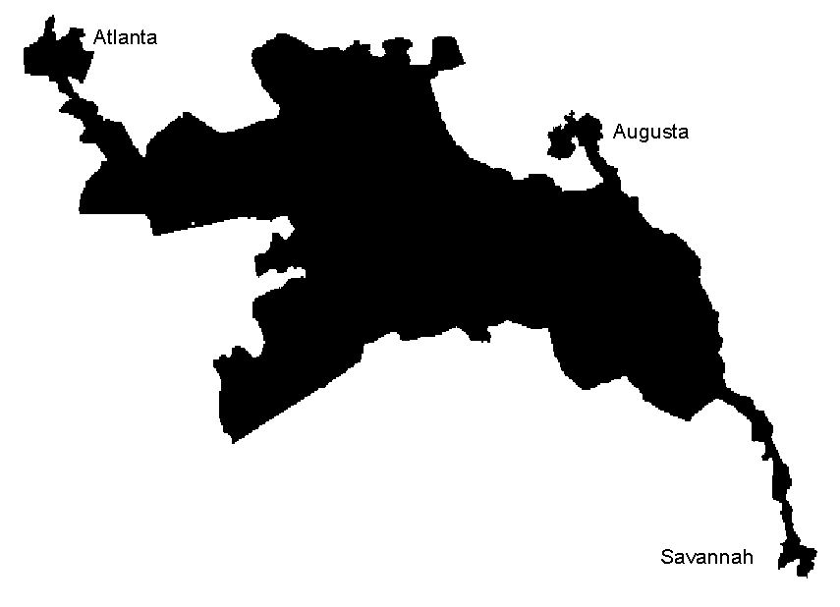
Next Lecture
Pages 755-768
Last lecture!
End of course
Representation
Reynolds v. Sims (1964)
Miller v. Johnson (1995)

