Slide 1
Lecture 51 Voting and Representation V
Political Representation

Slide 2
This lecture
Pages 755-768
Last lecture!
End of course
Representation
Reynolds v. Sims (1964)
Miller v. Johnson (1995)

Slide 3
What about districts?
Gerrymandering→ racial and political
Population equality-→ Should districts be of equal size?→ one person, one vote?
As the population shifted from rural to urban, districts didn’t follow
This led to entrenched rural interests dominating things
Colegrove v. Green (1946)
Court says this is a political question and thus not justiciable
Baker v. Carr (1962)
Court changes its mind and says that it is a question the Courts can answer
Wesberry v. Sanders (1964)
The Court overturns Georgia’s congressional district map because districts were of vastly different sizes
But this had authority in the Constitution Article I, Section 2

Slide 4
Reynolds v. Sims (1964)
Background
Challenge to Alabama’s State Legislative districts
The districts had not been changed since 1901
Rural districts were underpopulated while urban districts were overpopulated
In the House, every county had to have at least one district
In the Senate the disparity was 41 to 1
This was challenged as a violation of the 14th Amendment Equal Protection Clause
The state’s remedy was insufficient
There were challenges to many other state legislative redistricting plans

Slide 5
Reynolds v. Sims- II
Arguments
For Alabama
The Court should overrule Baker v. Carr and give this power back to states
The Alabama system is similar to the way Congress is represented
Population disparities are okay to protect rural interests from large cities
For Sims
Baker v. Carr should be reaffirmed
These plans are malapportioned and violate the Equal Protection Clause of the 14th Amendment
The Court should impose a new plan with balanced districts

Slide 6
Reynolds v. Sims- III
Warren, C.J. for an 8-1 Court
Legislators represent people, not trees or acres
Legislators are elected by voters, not farms or cities or economic interests
Certain voters should not be given extra weight than others
Dilution of vote weights violations the Equal Protection Clause of the 14th Amendment
The country has changed from rural to urban
It does not matter how the federal Congress is designed given history
The remedy proposed by Alabama does not meet muster
Districts should be roughly the same in size

Slide 7
Reynolds v. Sims- IV
Harlan, J. dissenting
He sees most redistricting plans will fall due to this ruling
He thinks the courts go too far in getting involved here and in the past
He thinks the 14th Amendment does not require district population equality
States should be able to choose the systems for electing their legislatures best suited to themselves

Slide 8
Equality of Population
Karcher v. Daggett (1983)- Zero deviation for U.S. House districts
However, most other districts are good if they stay within the +/-5% safe harbor
These rules apply to all districts, not just for legislatures

Slide 9
Minority Representation
Gomillion v. Lightfoot (1960)
Redistricting that removes black residents can be a 15th Amendment violation
United Jewish Organizations of Williamsburg v. Carey (1977)
Court upholds the use of minority majority districts
The Voting Rights Act in 1982 was amended to overrule part of City of Mobile v. Bolden (1980) on the drawing of minority majority districts
In 1992, many more minorities are elected to offices
Republicans join with minorities to do so
Shaw v. Reno (1993)
Some bizarrely shaped districts may be illegal
Separating voters by race subject to strict scrutiny

Slide 10
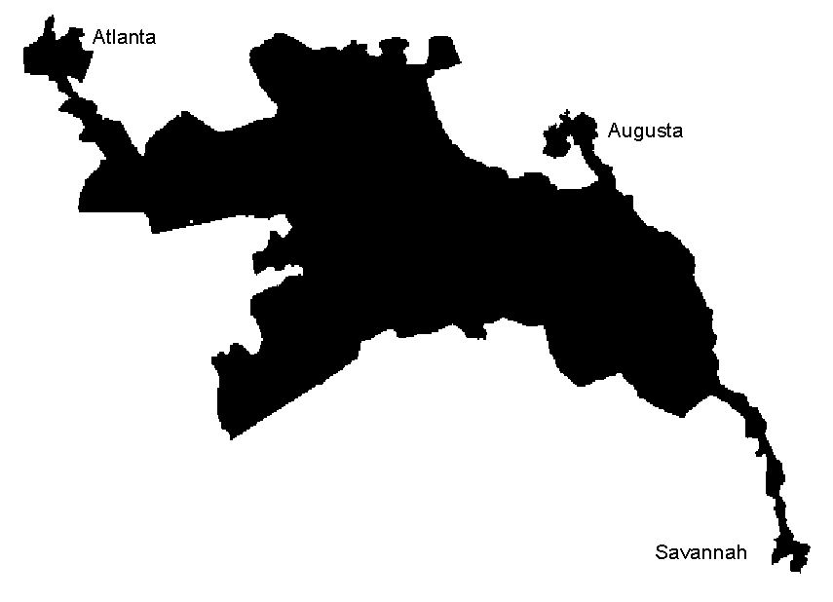
Miller v. Johnson (1995)
Background
Georgia gains one seat after the 1990 Census (10→11)
There had previously been only one black majority seat
The Bush Justice Department demanded three
The 11th district was strangely shaped and was 60% black
It was struck down based on Shaw that is was primarily drawn for race

Slide 11
Miller v. Johnson- II
Arguments
For Zell Miller and Georgia
The district court relied too much on intent
The shape of this district is not irregular, even if drawn to create a minority majority seat
The standard for bizarrely shaped districts should look to traditional districting principals
For Johnson (challenging the maps)
The state drew a black majority district against traditional districting principals
The lines are subject to strict scrutiny
The lines cannot be explained for any reason other than race
This district was not required to be drawn by the VRA or Constitution

Slide 12
Miller v. Johnson- III
Kennedy, J. for a 5-4 Court
This plan is subject to strict scrutiny and it fails
Shaw says that districts may not be drawn to separate voters on the basis of race
This can lead to racial Balkanization or even racial apartheid (O’Connor)
Key: Was race the predominant factor in the drawing of a district?
Then you apply strict scrutiny
Subordinated traditional race-neutral districting principals such as compactness, contiguity, respect for political subdivisions or communities to racial considerations
The Court later says that partisanship can be one of those, but then backtracks
It was “exceedingly obvious” from the shape that race was the predominant factor
The 11th district easily fails this test

Slide 13
Miller v. Johnson- IV
Ginsburg, J. dissenting, joined by Stevens, Breyer, and Souter, JJ.
She does not agree with strict scrutiny or the racial predominance rule here
These districts were drawn for more than just racial factors

Slide 14
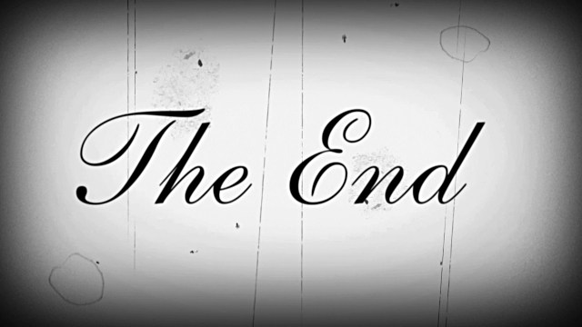
Next Lecture
None!
We are finished with the course!

