Slide 1
Lecture 6 Chapter 4
Religion Definition and Free Exercise I (Valid Secular Policy)

Slide 2
Major Cases in this Chapter
Free Exercise
Establishment Clause
Cantwell v. Connecticut (1940)
Sherbert v. Verner (1963)
Wisconsin v. Yoder (1972)
Employment Division, Department of Human Resources of Oregon v. Smith (1990)
City of Boerne v. Flores (1997)
Everson v. Board of Education (1947)
School District of Abdington Township v. Schempp; Murray v. Curlett (1963)
Lemon v. Kurtzman; Earley v. DiCenso (1971)
Zelman v. Simmons-Harris (2002)
Edwards v. Aguillard (1987)
Town of Greece v. Galloway (2014)
Van Orden v. Perry (2005)
Hosanna-Tabor Evangelical Lutheran Church and School v. Equal Employment Opportunity Commission (2012)

Slide 3
This Lecture…
This lecture discusses some introductory material on Religion Clauses
Please skim pages 91-94 on your own
This covers pages 95-105
Defining Religion
Valid Secular Policy Test

Slide 4
A Little Historical Primer
America is one of the more religious countries in the western world today
But less so that before
Rising secular trend among the young
However, at the founding many states had established religions
Some kept them into the 1840s
Many had religious tests for office
Religion appears only twice in the Constitution
Article VI → no religious tests for federal office
The First Amendment
Congress shall make no law respecting an establishment of religion, or prohibiting the free exercise thereof

Slide 5
Defining Religion
How do we define what a religion is?
Some are relatively easy since they are large, well-known and existed a long time
Davis v. Beason (1890)
Court makes references to relations to a creator and the obligations they impose
Comes down to some belief in a God

Slide 6
Ballard approach
United States v. Ballard (1944)
Leaders of the “I am” movement
Founders claimed supernatural powers to heal, wealth, success, happiness
All one had to do was to send them money
The government said it was not a religion, but merely a fraud scheme
Douglas, J. writing for the Court said
Don’t consider the alleged truth of the doctrine
Consider the sincerity of the beliefs

Slide 7
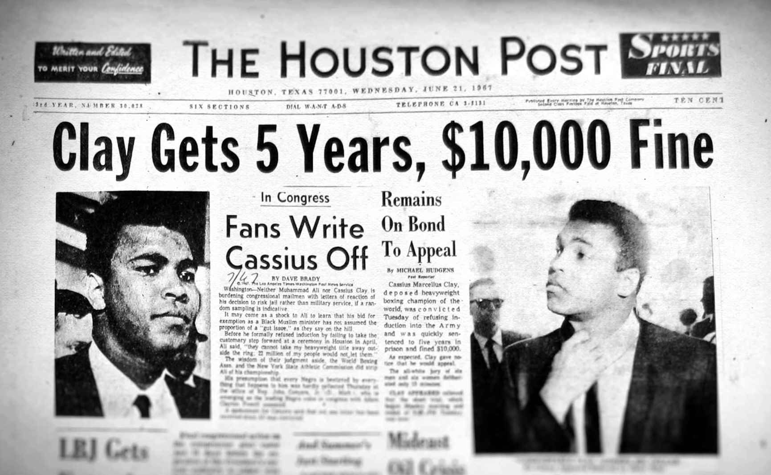
Conscientious Objectors
Congress passes protections in 1940
If they are opposed to participation in any form to war
Sicurella v. United States (1955)
Jehovah’s Witness case
Theoretical war participation does not preclude status if opposed to all real war
Used in Clay v. United States (1971)

Slide 8
Does one have to be a member of a religion?
Can a person qualify for status if they are not a member of an organized religion?
United States v. Seeger (1965)
Clark, J. writing→ reference to Supreme Being meant to exclude from those claiming status based on political, sociological, or philosophical views
One did not have to believe in God to claim an exemption
Welsh v. United States (1970)
Black, J. → Can claim status based on his moral or ethical views were sincerely held
Non-religious views may take on a religious character

Slide 9
Free Exercise Clause
The First Amendment
Congress shall make no law… prohibiting the free exercise thereof
Jefferson said it was not without limit → actions could be regulated
Reynolds v. United States (1879)
Congress may prohibit polygamy, despite Mormons in the Utah Territory practicing it as part of their religion
Chief Justice Waite said Congress was “left free to reach actions which were in violation of social duties or subversive of the good order
Pierce v. Society of Sisters (1925)
KKK backed anti-Catholic measure to make public school attendance compulsory
McReynolds, J. ruled for the Sisters, find they were engaged in a “useful and meritorious undertaking”

Slide 10
Cantwell v. Connecticut (1940)
Background
Appellants were Jehovah’s Witnesses in a largely Catholic neighborhood in New Haven, Connecticut
They were going house to house giving out pamphlets, and some took offense
They were arrested and charged under a state statute requiring a license to solicit
Questions
Should the Free Exercise Clause be incorporated against the states?
If yes, did the license policy violate the free exercise clause

Slide 11
Cantwell v. Connecticut- II
Arguments
For Cantwell
Statute denies them freedom to worship, thus violating the Due Process Clause of the 14th Amendment
This should be incorporated as a liberty
Door knocking is part of their religion
For Connecticut
State has the police power against fraud is the reason behind the law
Statute does not apply to ideas, but only solicitation
It is a proper delegation of authority to the Secretary of Public Welfare to determine the legitimacy of solicitors

Slide 12
Cantwell v. Connecticut- III
Roberts, J. delivers the unanimous opinion of the Court
This is a deprivation of liberty under the 14th Amendment
Thus applicable to state and local governments
Amendment includes the freedom to believe and the freedom to act
But the second is not absolute, and may be regulated
Too much discretion to deny to the Secretary
Connecticut possibly could have enforced a law if it included all solicitation for a non-religious government goal, such as fraud prevention
Key to the opinion- neutrality
Remember this as it may be making a comeback
If goal is secular, most laws would survive under this test

Slide 13
Applications of Valid Secular Policy Test
Minersville School District v. Gobitis (1940)
Another Jehovah’s Witness case
Involved refusal to pledge allegiance or salute flag (Nazi reference on the latter)
In an 8-1 decision, Frankfurter, J. upheld the law
Was for the secular purpose of fostering patriotism
Prince v. Massachusetts (1944)
Another Jehovah’s Witness case
Massachusetts law prohibited minors from selling magazines, newspapers, periodicals or other merchandise
Parents could be charged for allowing them to do so
A 5-4 Court, by Rutledge, J. found for the State
Court held that state has more authority over child welfare
Child labor laws represent secular policy

Slide 14
Next Lecture
We will move to a different test
The Compelling Interest Test
Two major cases- Sherbert and Yoder
Pages 105-115
This will take us through the Warren and Burger Courts

