Slide 1
Lecture 7 The Legislature
Part 3: Legislative Powers:
Oversight and Investigations

Slide 2
The Oversight Function
The power to investigate is quite important for Congress
Harry Truman made a name for himself investigating waste and war profiteering
Investigation of other branches
Kilbourn (1881) set out the factors for Congressional subpoena power and when it could hold someone in contempt for failure to comply or testify
To review these factors from Kilbourn
Inquiries must not "invade areas constitutionally reserved to the courts or the executive"
Inquiries must deal "with subjects on which Congress could validly legislate"
The resolution authorizing the investigation must specify " a congressional interest in legislating on that subject."
Where the inquiry can result in "no valid legislation," then the "Private affairs of individuals" are not valid targets for inquiry

Slide 3
McGrain v. Daugherty (1927)
McGrain v. Daugherty (1927)
Background
Investigation of the Teapot Dome scandal
Bribery of public officials to get oil leases
Congress thought the AG Daugherty may have been involved and had a stake in failing to prosecute because he might be implicated
Daugherty resigned as AG
The Senate called his brother to testify and produce records
He refused, and was arrested for contempt
AG Daugherty was tried twice for corruption, but each ended in a hung jury

Slide 4
McGrain v. Daugherty- II
Question: Does Congress have the authority to subpoena a private individual to testify before a committee?
The Senate said yes
Compelling testimony had been the practice for several years
The inquiry was legislative in nature- it may lead to legislation
Daugherty said no
This was more of a judicial inquiry
The committee was trying the case for guilt or innocence
Congress is not vested with judicial power
Congress has no authority to arrest to compel testimony
Even if it does, it must be related to some proposed matter of legislation

Slide 5
McGrain v. Daugherty- III
Justice Van Devanter ruled for the unanimous Court
An implied power
Congress is granted with not just expressed powers, but such auxiliary powers that are necessary and proper to make the express powers effective
Congress has no general power, but a limited power here
The Justice Department is subject to legislative regulation
“one on which legislation could be had and would be materially aided by the information which the investigation was calculated to elicit”
Witnesses do have some rights
A witness may refuse to answer where the bounds of the power are exceeded or questions are not pertinent to the matter under inquiry

Slide 6
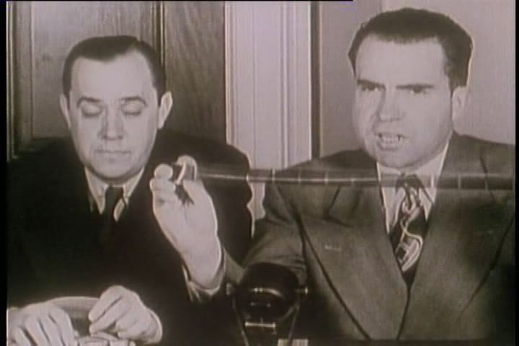
Watkins v. United States (1957)
Watkins v. United States (1957)
Background
Un-American Activities (HUAC committee later)
Started in 1918, but ended in 1975
Used to investigate alleged Communists, but also left-leaning organizations
Unions, Alger Hiss, Hollywood, academia, State Department, United Nations ˃ Red Scare
Sen. Joseph McCarthy (R-Wisconsin) had his own Senate Committee
Many of these hearings were televised- Nixon used it to make a name
In this case, Watkins answered some questions, but refused to answer others that he felt were outside the proper scope of the committee
He refused to answer as other past associates that may have been Communists
The House sent the case to the U.S. Attorney for prosecution for contempt
Watkins was convicted and sentence to a $100 fine and a year suspended prison sentence

Slide 7
Watkins v. United States- II
Arguments
For Watkins
Congress has limited power
The refused questions went beyond the scope of the committee’s authorization
The authorization was too vague
For the government
Acting pursuant to valid legislation
The inquiry could lead to potential further legislation
There is an informing function of the Congress as an implied power

Slide 8
Watkins v. United States- III
Chief Justice Warren wrote for a 6-1 Court
Power for Congress to conduct investigations is broad
Existing laws, and needed or proposed ones
But the power is not unlimited
Not to expose private affairs of individuals without justification
Congress said one purpose was to know of attempts to overthrow the government
The Court rules for Watkins
The committee thought it had unlimited power- it didn’t
The resolution authorizing was overly vague
Lack of sufficient information provided to Watkins
His Due Process rights were violated

Slide 9
Watkins v. United States- IV
Frankfurter, J. concurring
The scope of the inquiry must be authorized and defined with “unambiguous clarity” to safeguard the witness from the hazards of vagueness
There is a line of cases in criminal law- “void for vagueness”
Clark, J. dissenting
The Court should not have interfered with the committee system of inquiry
This is a violation of separation of powers
He thinks the scope and purpose were set out with “undisputable clarity”

Slide 10
Barenblatt v. United States (1959)
Barenblatt v. United States (1959)
Background
More from the HUAC committee
This was on communist infiltration (allegedly) or education
Crowley said he had belonged to a club at the University of Michigan as a graduate student linked to the Communist Party and his roommate did as well
Crowley lost his job at Vassar after the subpoena
Barenblatt refused to answer questions relating to whether he was a member of the Communist Party
Barenblatt was held in contempt and successfully prosecuted for it by the U.S. Attorney
Notice that Congress relies on the D.C. U.S. Attorney to prosecute these?

Slide 11
Barenblatt v. United States- II
Question: Did these questions violate his First Amendment rights and exceed the scope of Congress’ powers?
Arguments:
For Barenblatt
Based on Watkins, the language of the investigatory statute language was too vague, therefore they lack the power here
He did not know why he was subpoenaed
The questions violated his First Amendment rights of express and speech
For the government
Watkins merely criticized the authorizing resolution, it didn’t overturn it
The overall goal was to investigate Communists and their danger to the country

Slide 12
Barenblatt v. United States- III
Justice Harlan writes the 5-4 decision
Barenblatt was well aware of the subcommittee’s authority and purposes of the questions
The First Amendment does not act as the Fifth Amendment’s protection against self-incrimination for a refusal to testify
There is a balance between the First Amendment and Congress’ interests
Congress has a legitimate interest in identifying Communist activity
It aided the legislative process

Slide 13
Barenblatt v. United States- III
Black, J. dissenting
He disagrees that there should be a balancing process when it comes to the First Amendment
It attempts inquiry into beliefs, not action – ideas and associations, not conduct
He also says that Watkins never authorized this balancing
He then argues the Court did not apply the balancing test it devised correctly
Punishing him and others for their thoughts from years past
He dislikes the committee- punishment by humiliation and public shame
Most of the people at Michigan who refused to testify lost their jobs
The publicity equaled punishment
Black had a reputation of being an absolutist on the First Amendment
Shall make no law meant exactly what it said

Slide 14
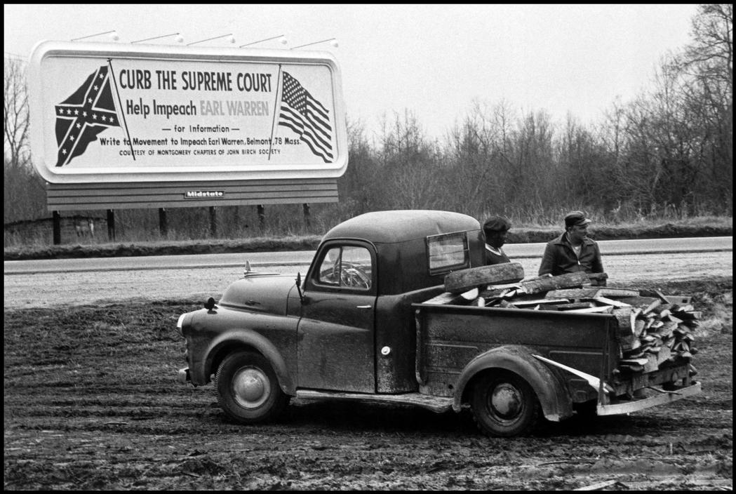
Barenblatt vs. Watkins
Were these cases consistent
Harlan’s opinion could be a clarification
Or was it to back of Watkins due to public and Congressional pressure?
Justices “felt the heat”
Some new Eisenhower appointees entered the Court
Court rulings in favor of civil liberty claims fell from 74% to 51%
Gibson v. Florida Legislative Investigating Committee (1963)
A state committee found a NAACP leader in contempt for failing to turn over his membership list
Contempt conviction was reversed- the NAACP not subversive
Subversive is how they distinguished from Barenblatt

Slide 15
The next lecture
We will examine the amendment enforcing powers of Congress
And inherent powers
Also there is a brief section on constitutional interpretations
The lead case is Katzenbach
We will cover pages 171-180

